Slide 1
PCA

Slide 2
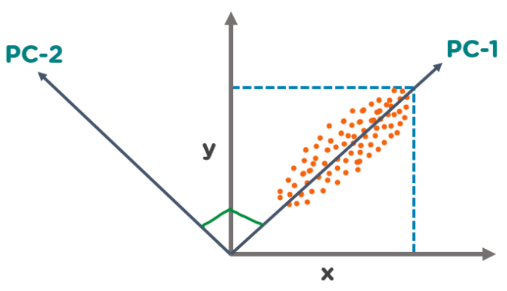
What is Principal Component Analysis?
The Principal Component Analysis is a popular unsupervised learning technique for reducing the dimensionality of data. It increases interpretability yet, at the same time, it minimizes information loss.
It helps to find the most significant features in a dataset and makes the data easy for plotting in 2D and 3D. PCA helps in finding a sequence of linear combinations of variables.
In the figure, we have several points plotted on a 2-D plane. There are two principal components. PC1 is the primary principal component that explains the maximum variance in the data. PC2 is another principal component that is orthogonal to PC1.

Slide 3
What is a Principal Component?
The Principal Components are a straight line that captures most of the variance of the data. They have a direction and magnitude.
Principal components are orthogonal projections (perpendicular) of data onto lower-dimensional space.
The main idea behind PCA is to figure out patterns and correlations among various features in the data set.
On finding a strong correlation between different variables, a final decision is made about reducing the dimensions of the data in such a way that the significant data is still retained.
Such a process is very essential in solving complex data-driven problems that involve the use of high-dimensional data sets. PCA can be achieved via a series of steps. Let’s discuss the whole end-to-end process.

Slide 4
Applications of PCA in Machine Learning
PCA is used to visualize multidimensional data.
It is used to reduce the number of dimensions in healthcare data.
PCA can help resize an image.
It can be used in finance to analyze stock data and forecast returns.
PCA helps to find patterns in the high-dimensional datasets.

Slide 5
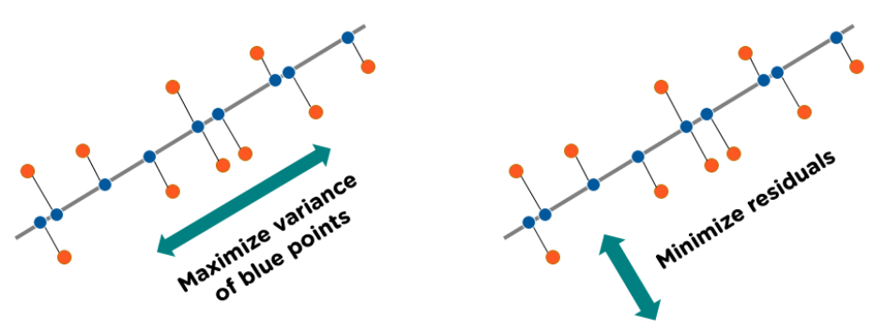
How does Principal Component Analysis Work?

Slide 6
Step By Step Computation Of PCA
The below steps need to be followed to perform dimensionality reduction using PCA:
Standardization of the data
Computing the covariance matrix
Calculating the eigenvectors and eigenvalues
Computing the Principal Components
Reducing the dimensions of the data set

Slide 7
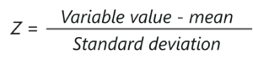
Step 1: Standardization of the data
If you’re familiar with data analysis and processing, you know that missing out on standardization will probably result in a biased outcome. Standardization is all about scaling your data in such a way that all the variables and their values lie within a similar range.
Consider an example, let’s say that we have 2 variables in our data set, one has values ranging between 10-100 and the other has values between 1000-5000. In such a scenario, it is obvious that the output calculated by using these predictor variables is going to be biased since the variable with a larger range will have a more obvious impact on the outcome.
Therefore, standardizing the data into a comparable range is very important. Standardization is carried out by subtracting each value in the data from the mean and dividing it by the overall deviation in the data set.
It can be calculated like so:

Slide 8
Step 2: Computing the covariance matrix
As mentioned earlier, PCA helps to identify the correlation and dependencies among the features in a data set. A covariance matrix expresses the correlation between the different variables in the data set. It is essential to identify heavily dependent variables because they contain biased and redundant information which reduces the overall performance of the model.
Mathematically, a covariance matrix is a p × p matrix, where p represents the dimensions of the data set. Each entry in the matrix represents the covariance of the corresponding variables.

Slide 9
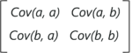
Step 2: Computing the covariance matrix
Consider a case where we have a 2-Dimensional data set with variables a and b, the covariance matrix is a 2×2 matrix as shown below:
In the above matrix:
Cov(a, a) represents the covariance of a variable with itself, which is nothing but the variance of the variable ‘a’
Cov(a, b) represents the covariance of the variable ‘a’ with respect to the variable ‘b’. And since covariance is commutative, Cov(a, b) = Cov(b, a)
Here are the key takeaways from the covariance matrix:
The covariance value denotes how co-dependent two variables are with respect to each other
If the covariance value is negative, it denotes the respective variables are indirectly proportional to each other
A positive covariance denotes that the respective variables are directly proportional to each other

Slide 10
Step 3: Calculating the Eigenvectors and Eigenvalues
Eigenvectors and eigenvalues are the mathematical constructs that must be computed from the covariance matrix in order to determine the principal components of the data set.
But first, let’s understand more about principal components
What are Principal Components?
Simply put, principal components are the new set of variables that are obtained from the initial set of variables. The principal components are computed in such a manner that newly obtained variables are highly significant and independent of each other. The principal components compress and possess most of the useful information that was scattered among the initial variables.
If your data set is of 5 dimensions, then 5 principal components are computed, such that, the first principal component stores the maximum possible information and the second one stores the remaining maximum info and so on, you get the idea.

Slide 11
Step 3: Calculating the Eigenvectors and Eigenvalues
Now, where do Eigenvectors fall into this whole process?
Assuming that you all have a basic understanding of Eigenvectors and eigenvalues, we know that these two algebraic formulations are always computed as a pair, i.e, for every eigenvector there is an eigenvalue. The dimensions in the data determine the number of eigenvectors that you need to calculate.
Consider a 2-Dimensional data set, for which 2 eigenvectors (and their respective eigenvalues) are computed. The idea behind eigenvectors is to use the Covariance matrix to understand where in the data there is the most amount of variance. Since more variance in the data denotes more information about the data, eigenvectors are used to identify and compute Principal Components.
Eigenvalues, on the other hand, simply denote the scalars of the respective eigenvectors. Therefore, eigenvectors and eigenvalues will compute the Principal Components of the data set.

Slide 12
Step 4: Computing the Principal Components
Once we have computed the Eigenvectors and eigenvalues, all we have to do is order them in the descending order, where the eigenvector with the highest eigenvalue is the most significant and thus forms the first principal component. The principal components of lesser significances can thus be removed in order to reduce the dimensions of the data.
The final step in computing the Principal Components is to form a matrix known as the feature matrix that contains all the significant data variables that possess maximum information about the data.

Slide 13
Step 5: Reducing the dimensions of the data set
The last step in performing PCA is to re-arrange the original data with the final principal components which represent the maximum and the most significant information of the data set. In order to replace the original data axis with the newly formed Principal Components, you simply multiply the transpose of the original data set by the transpose of the obtained feature vector.

Slide 14


Slide 15
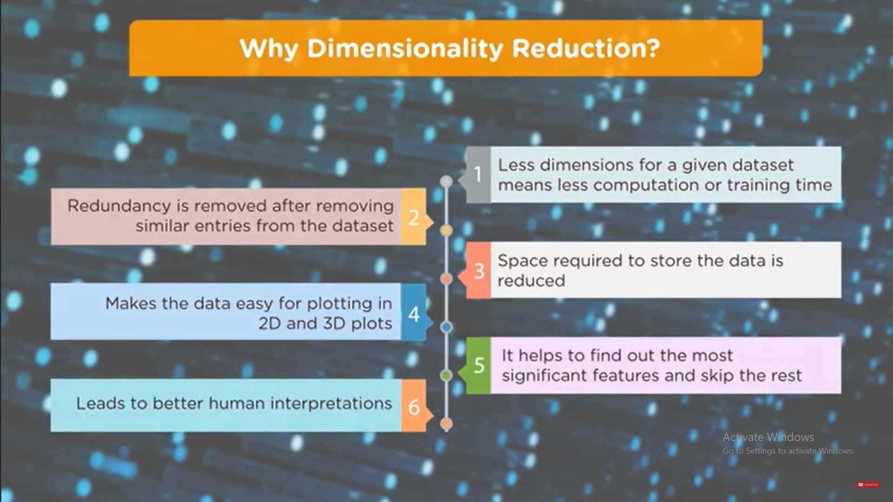

Slide 16
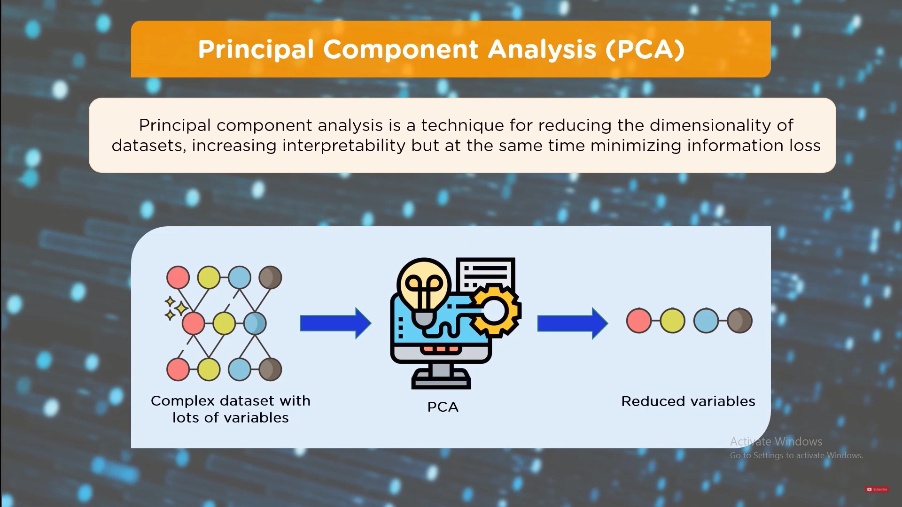

Slide 17


Slide 18
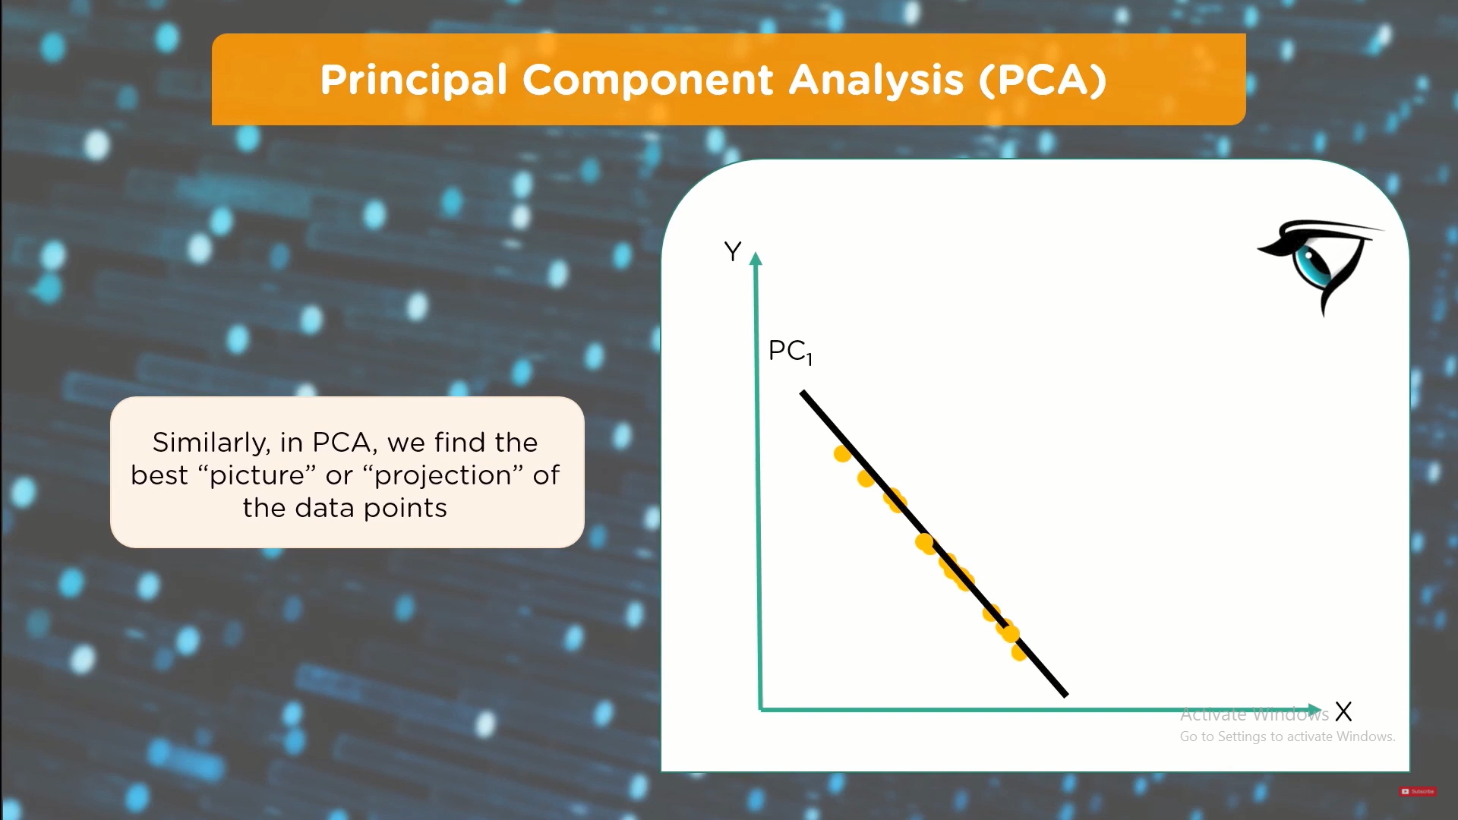

Slide 19
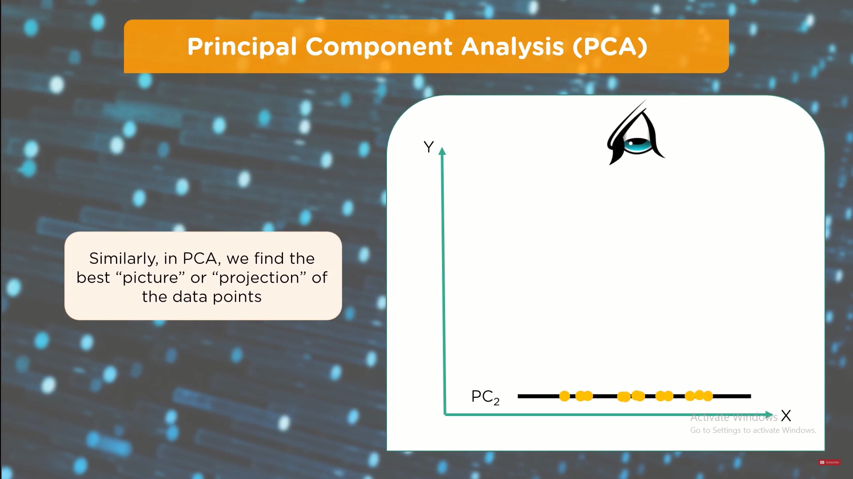

Slide 20
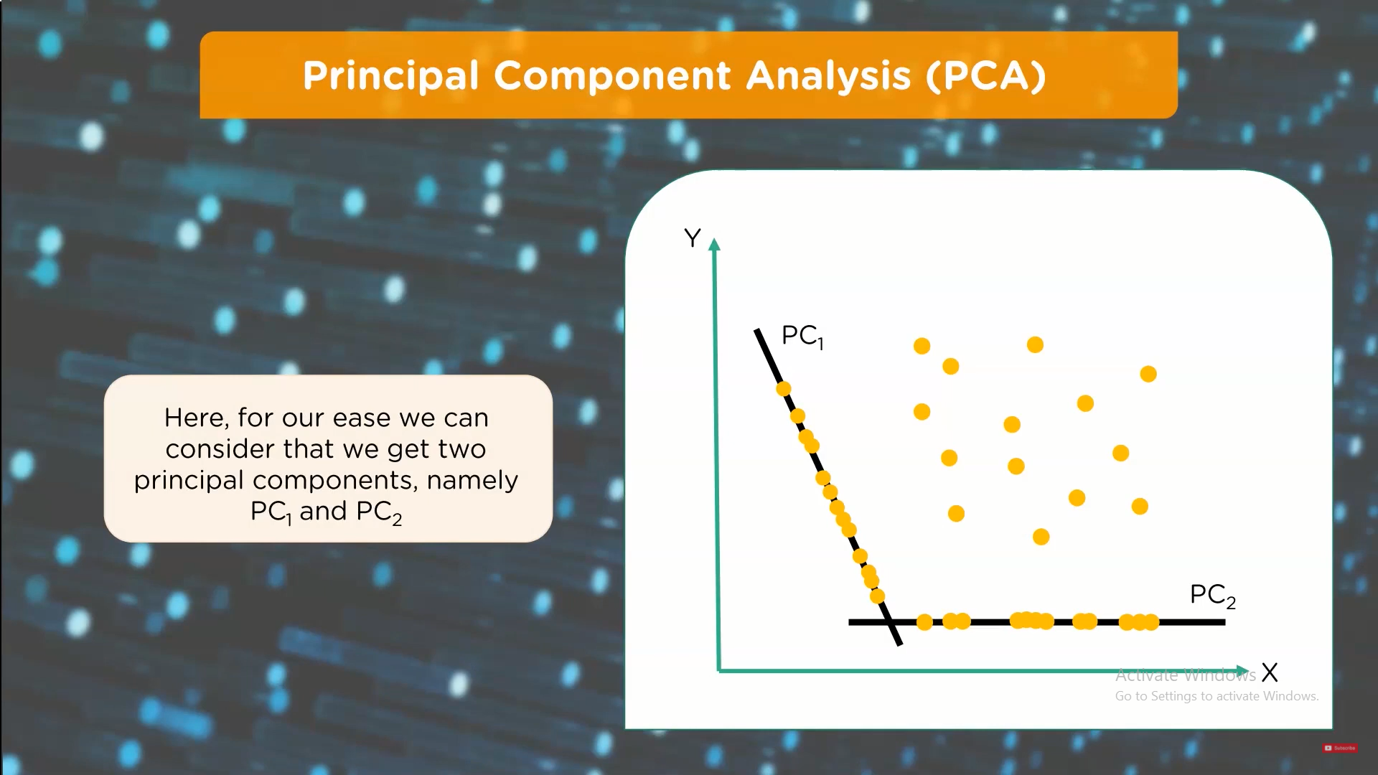

Slide 21
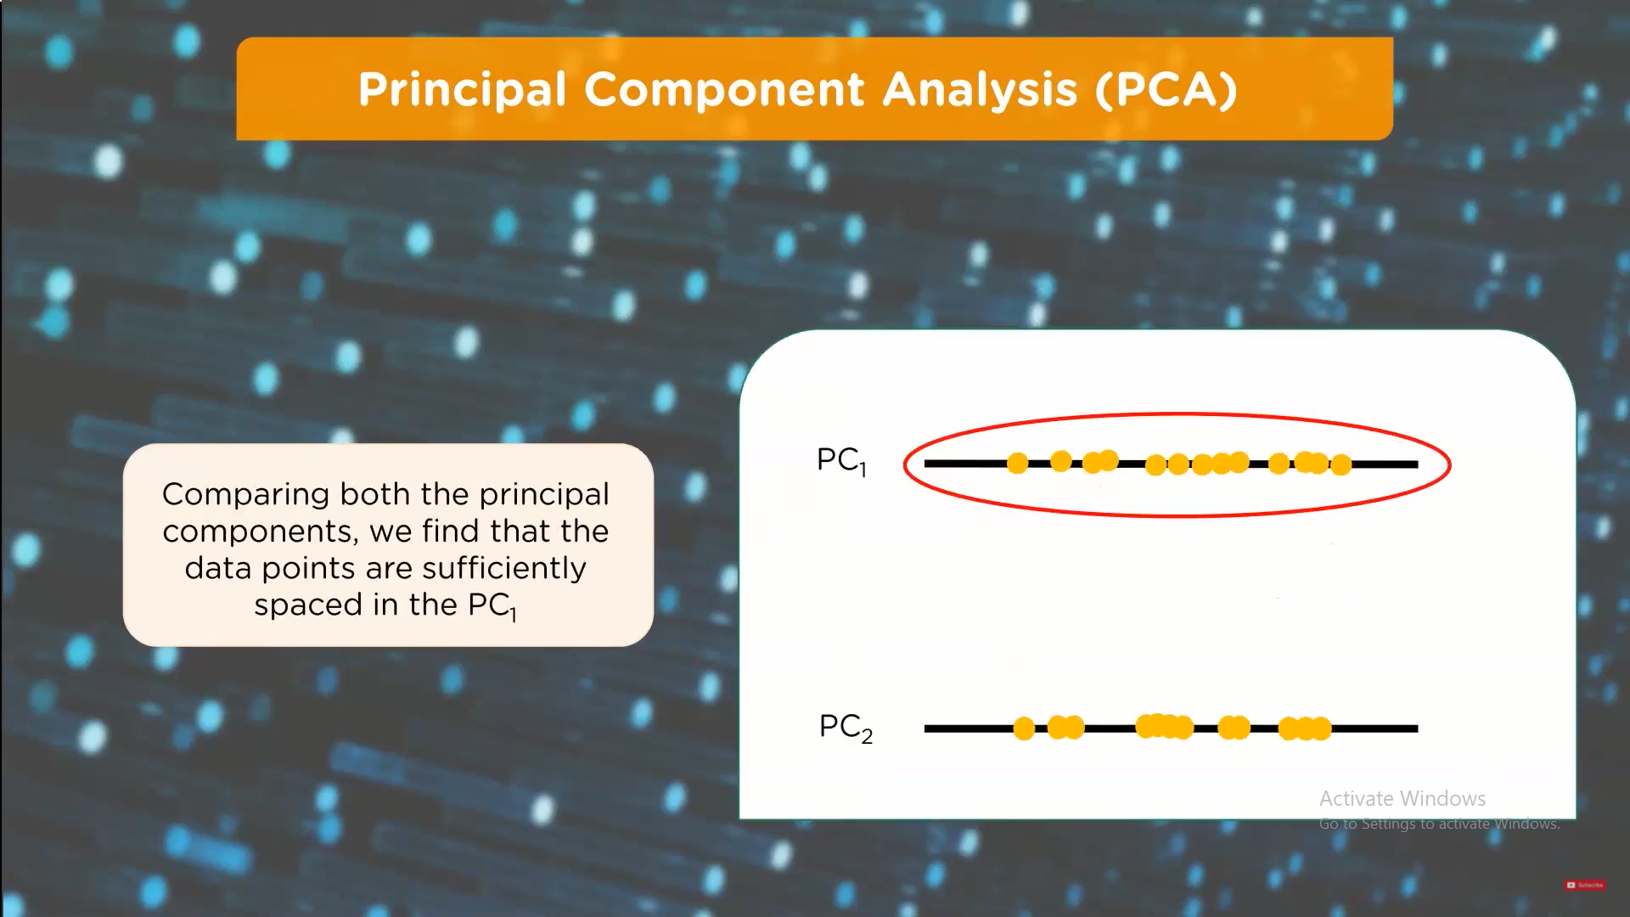

Slide 22
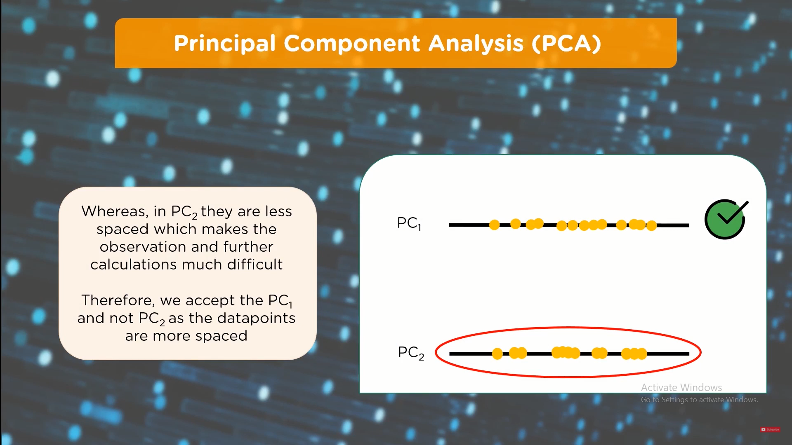

Slide 23
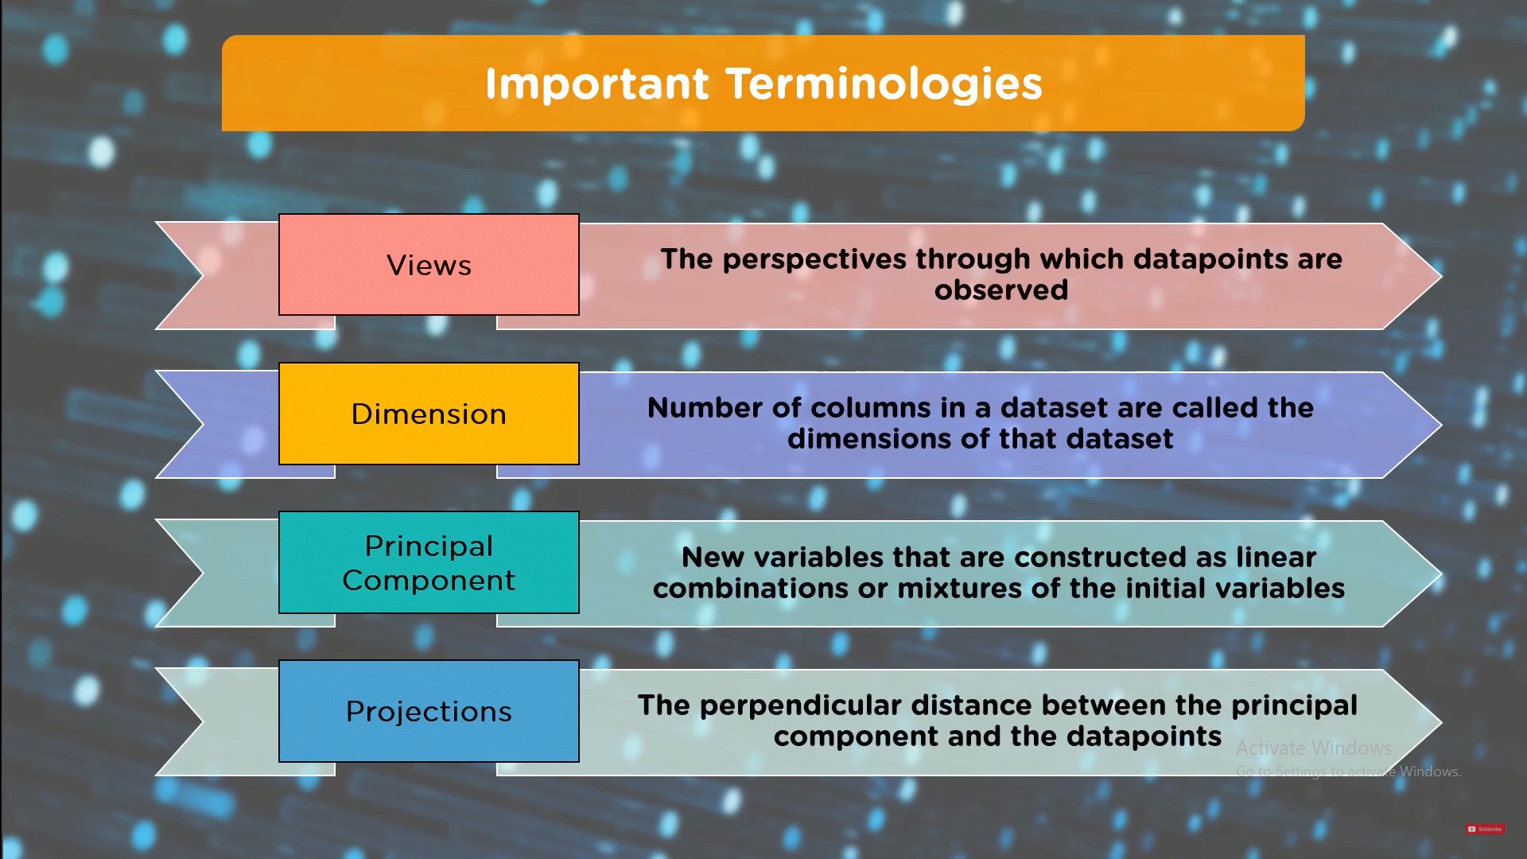

Slide 24


Slide 26


Slide 27
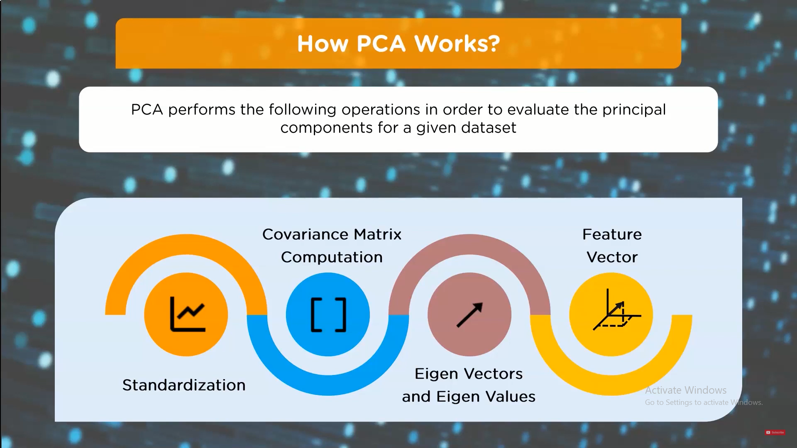

Slide 28
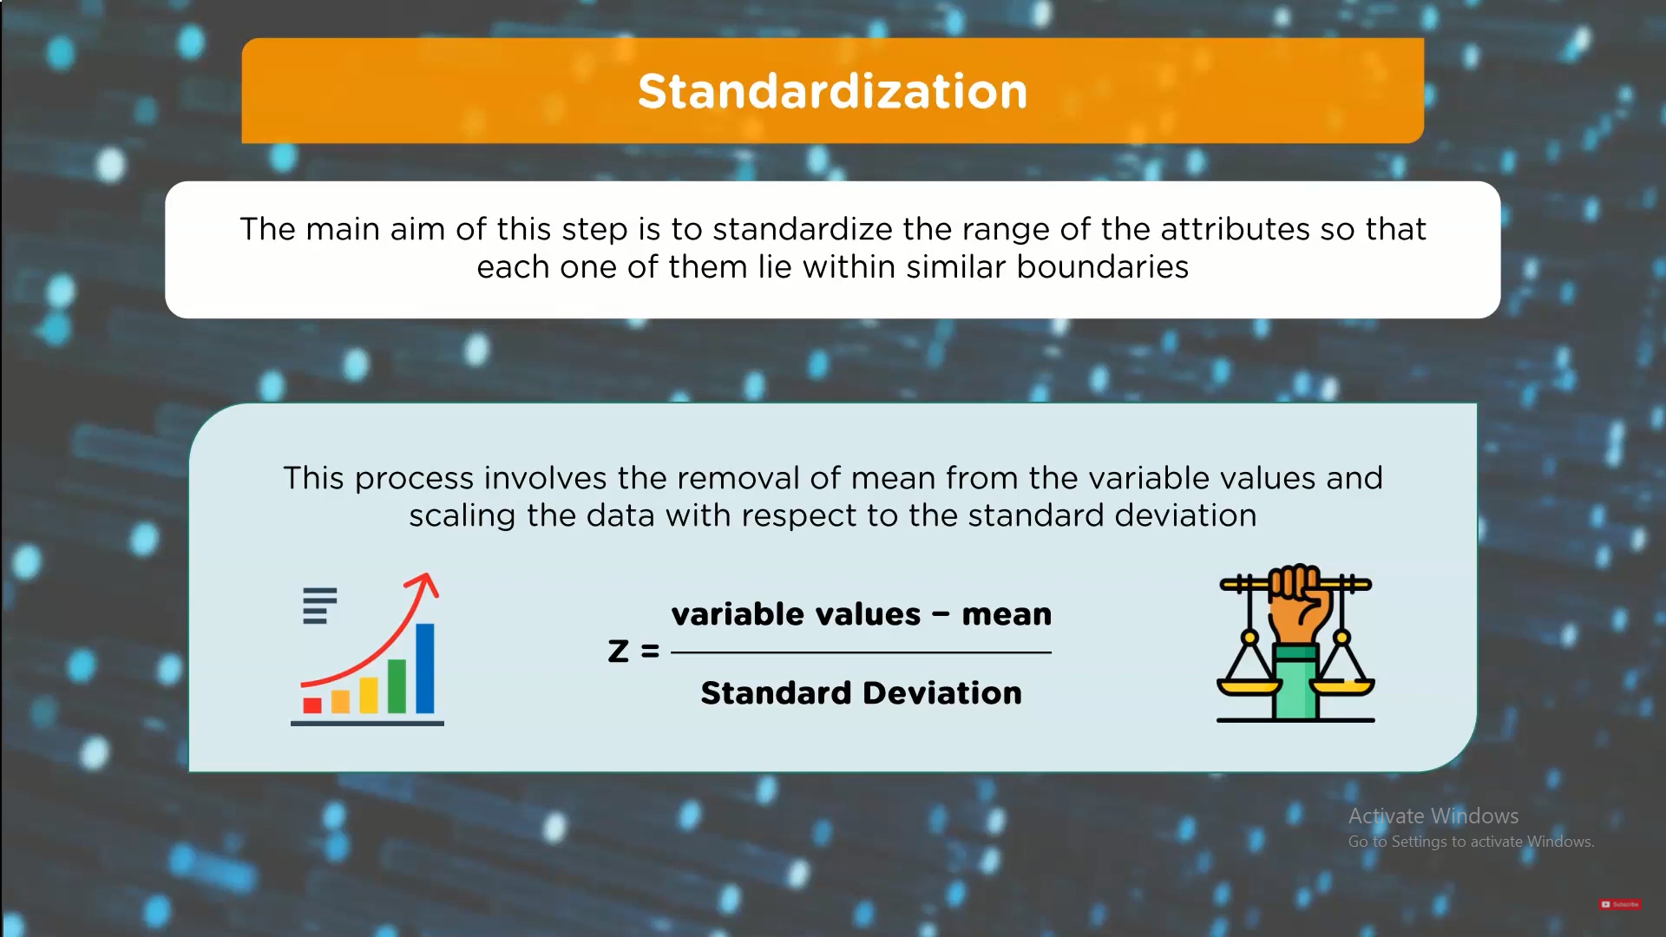

Slide 29
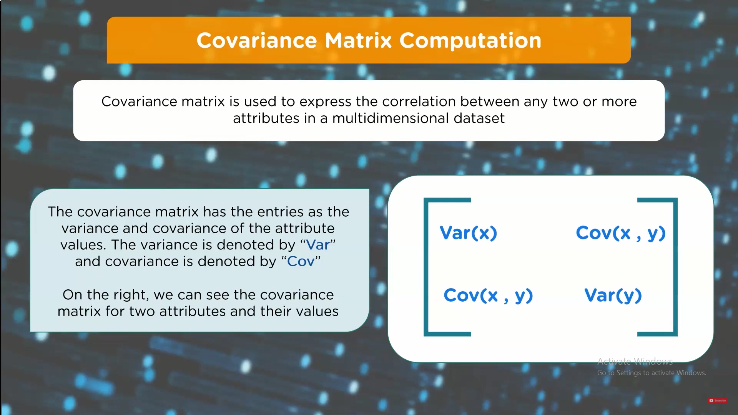

Slide 30
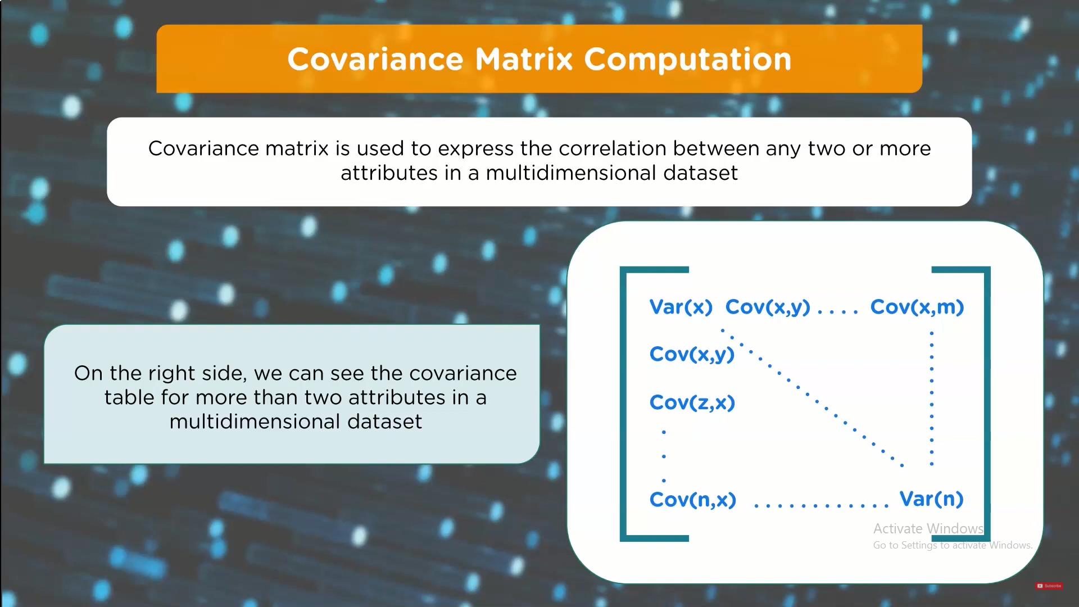

Slide 31
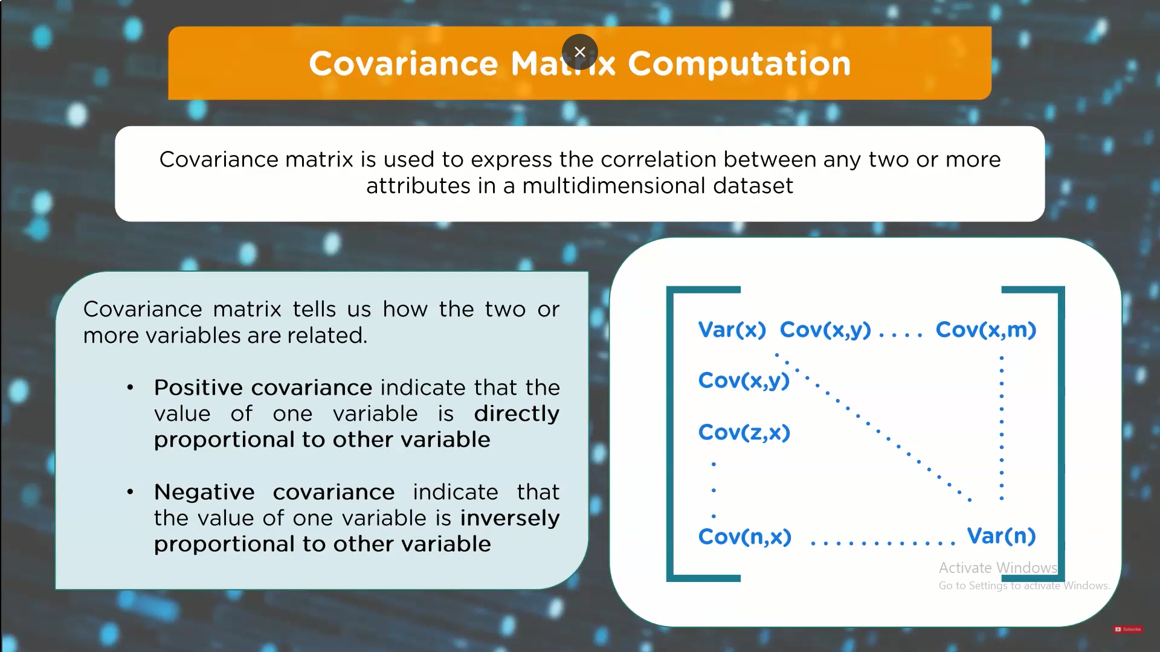

Slide 32
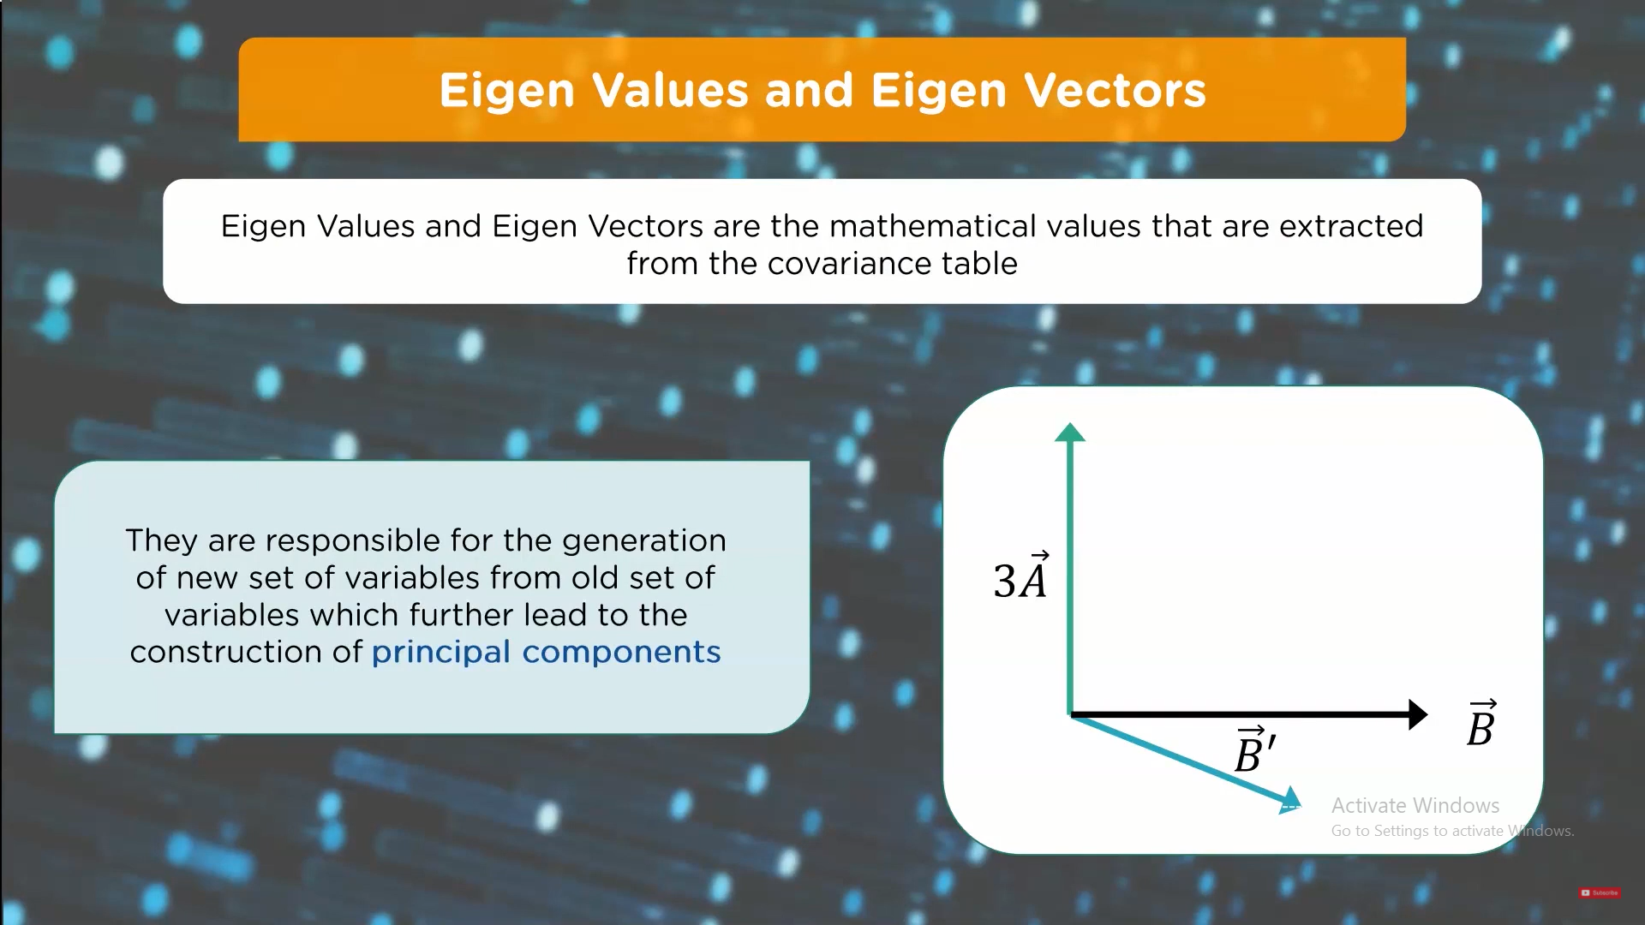

Slide 33


Slide 34


Slide 35
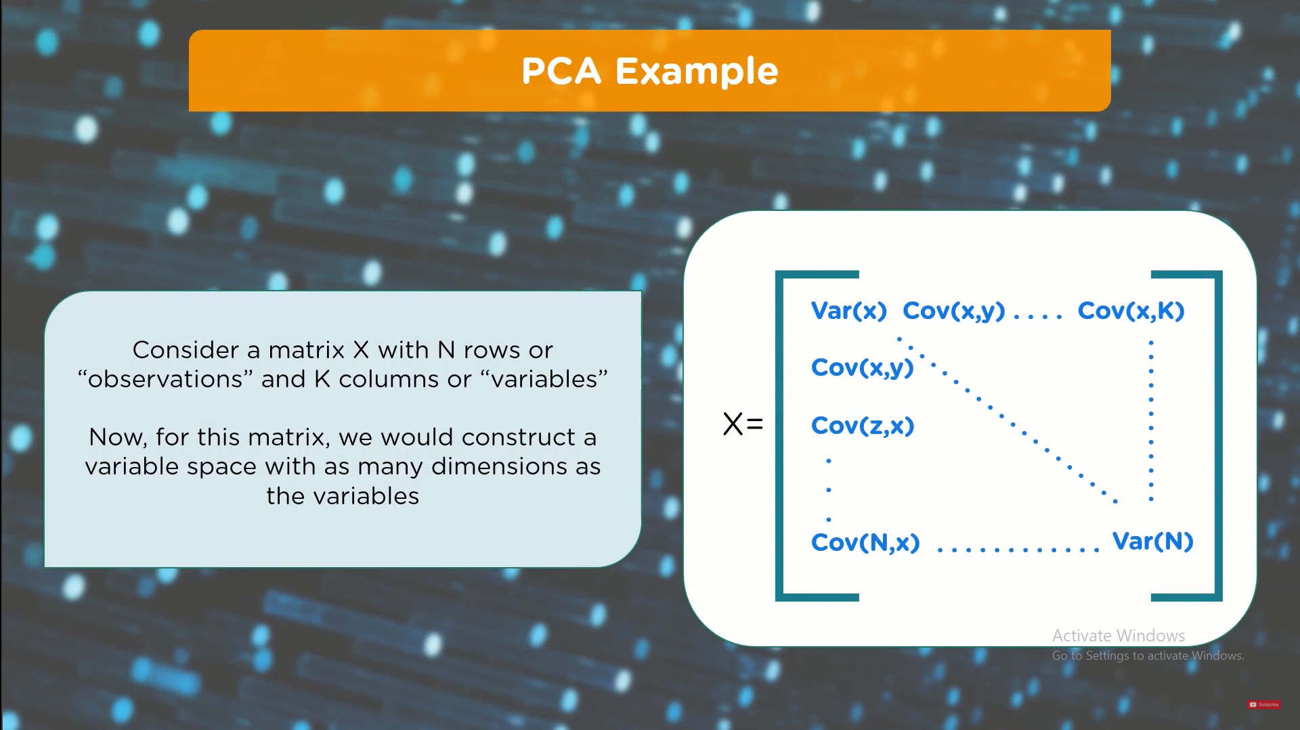

Slide 36
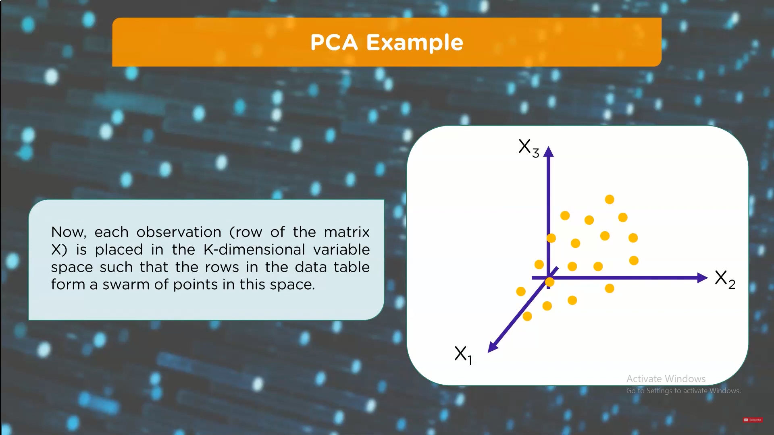

Slide 37
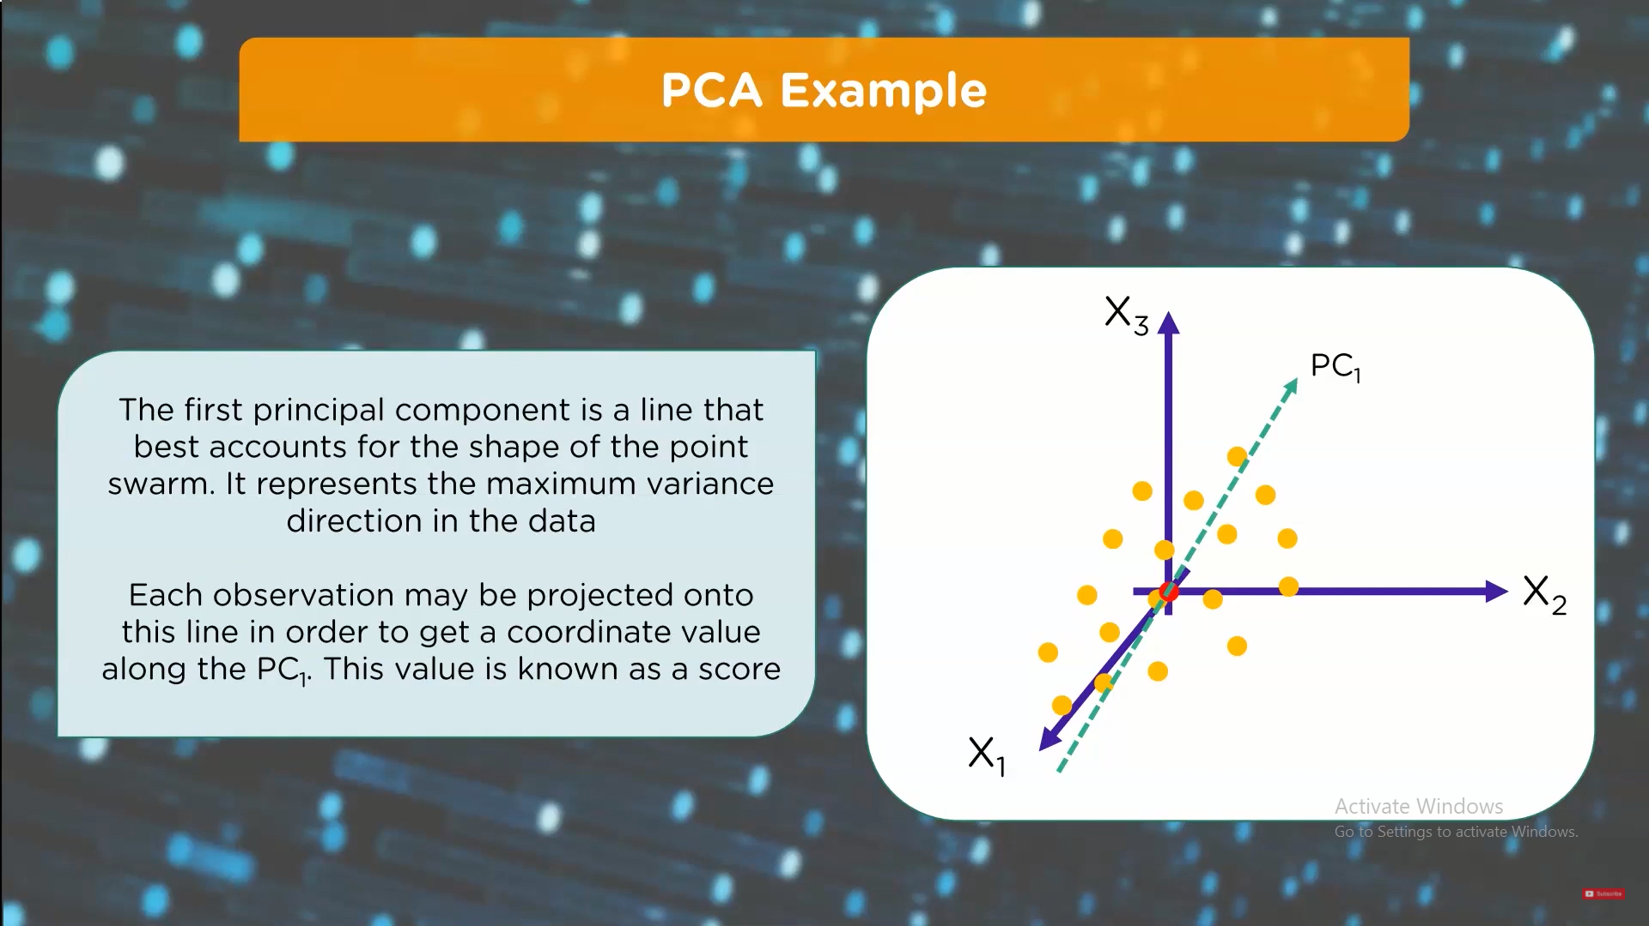

Slide 38
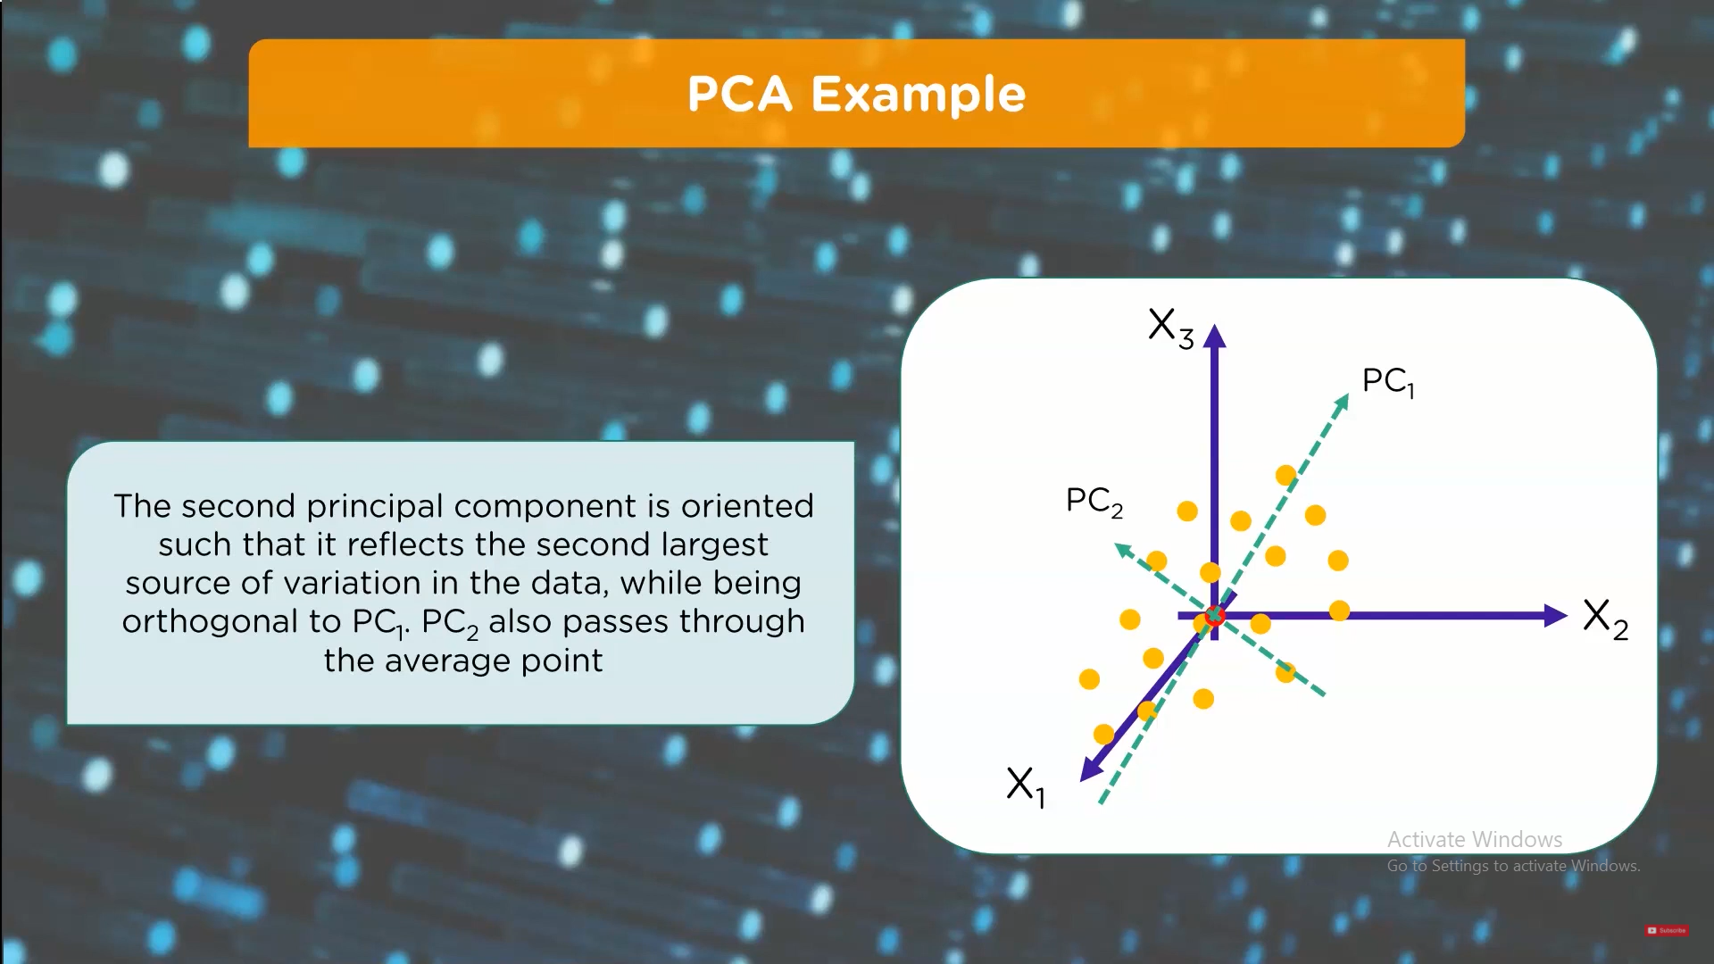

Slide 39
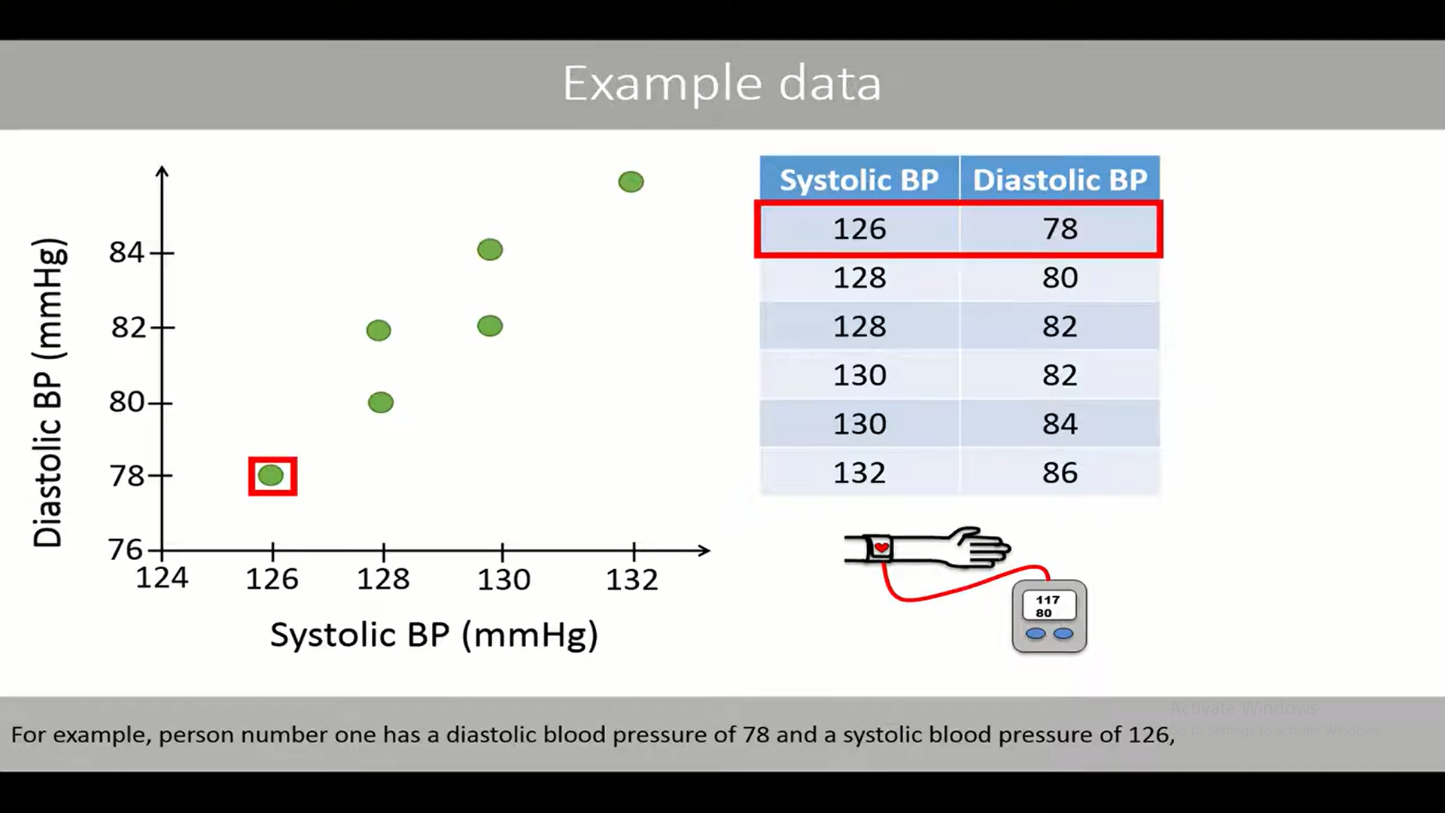

Slide 40
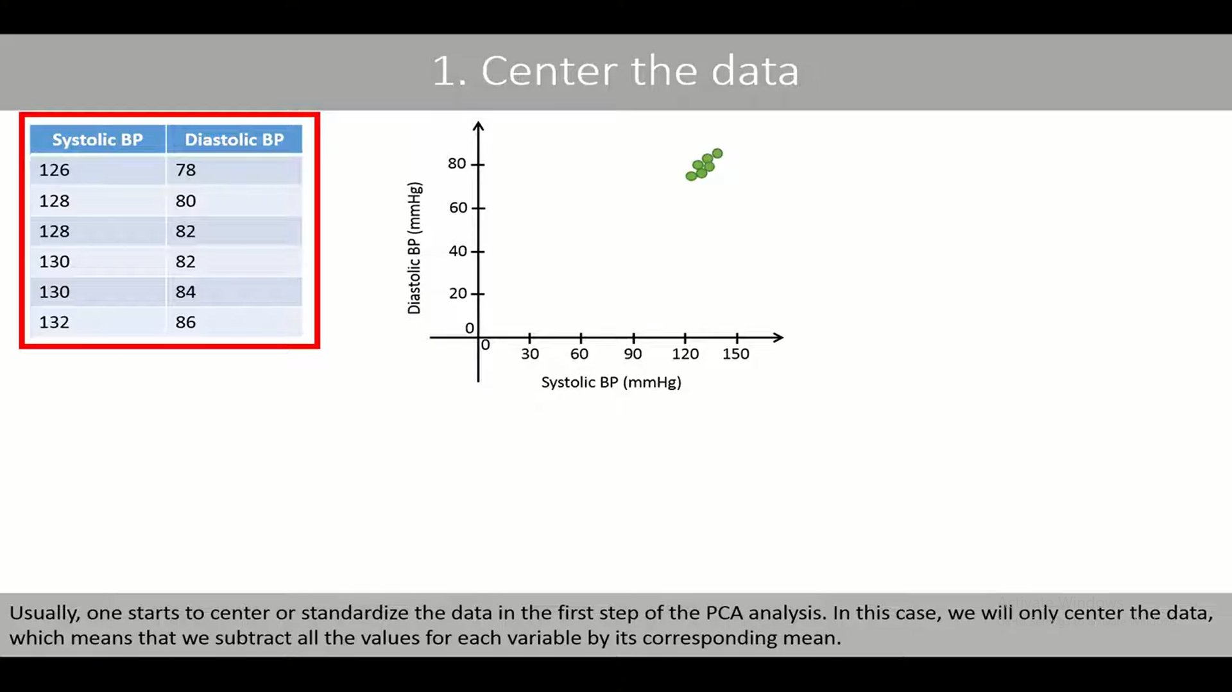

Slide 41
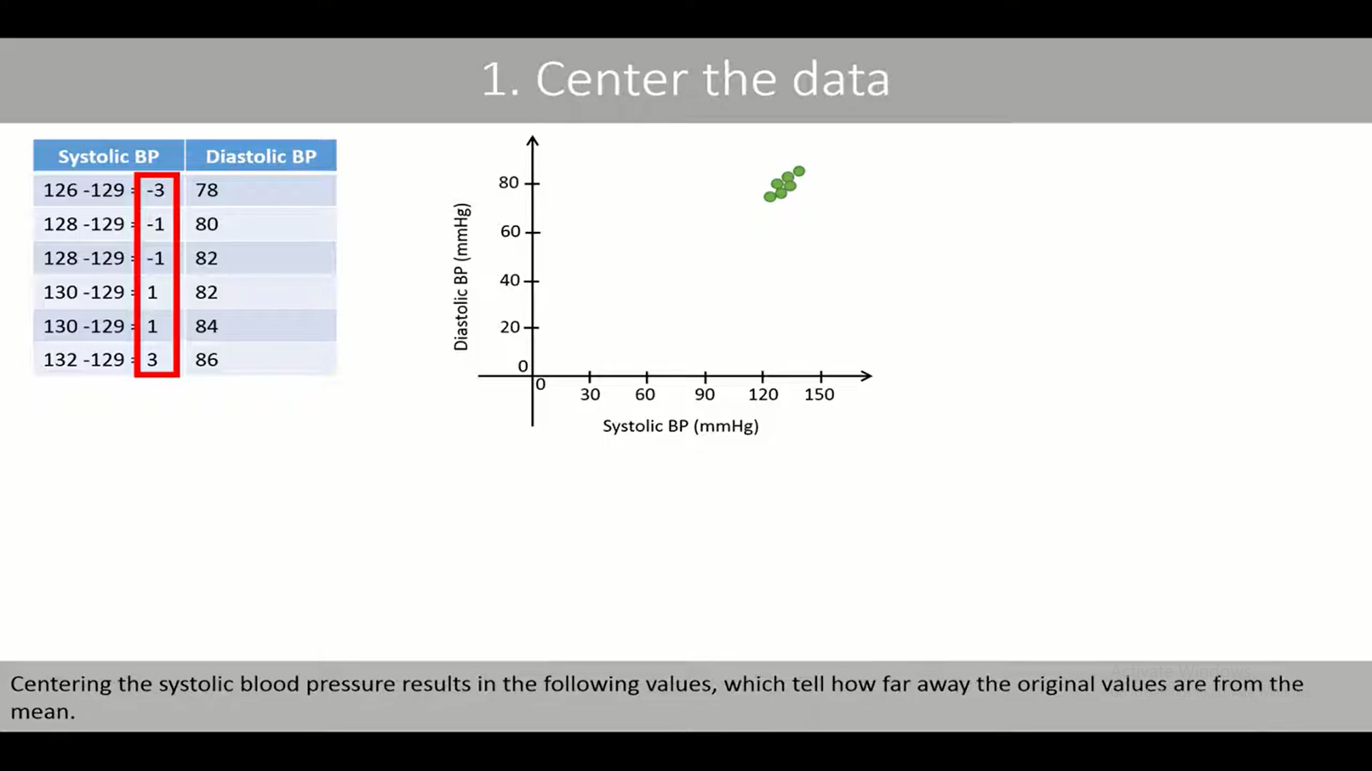

Slide 42
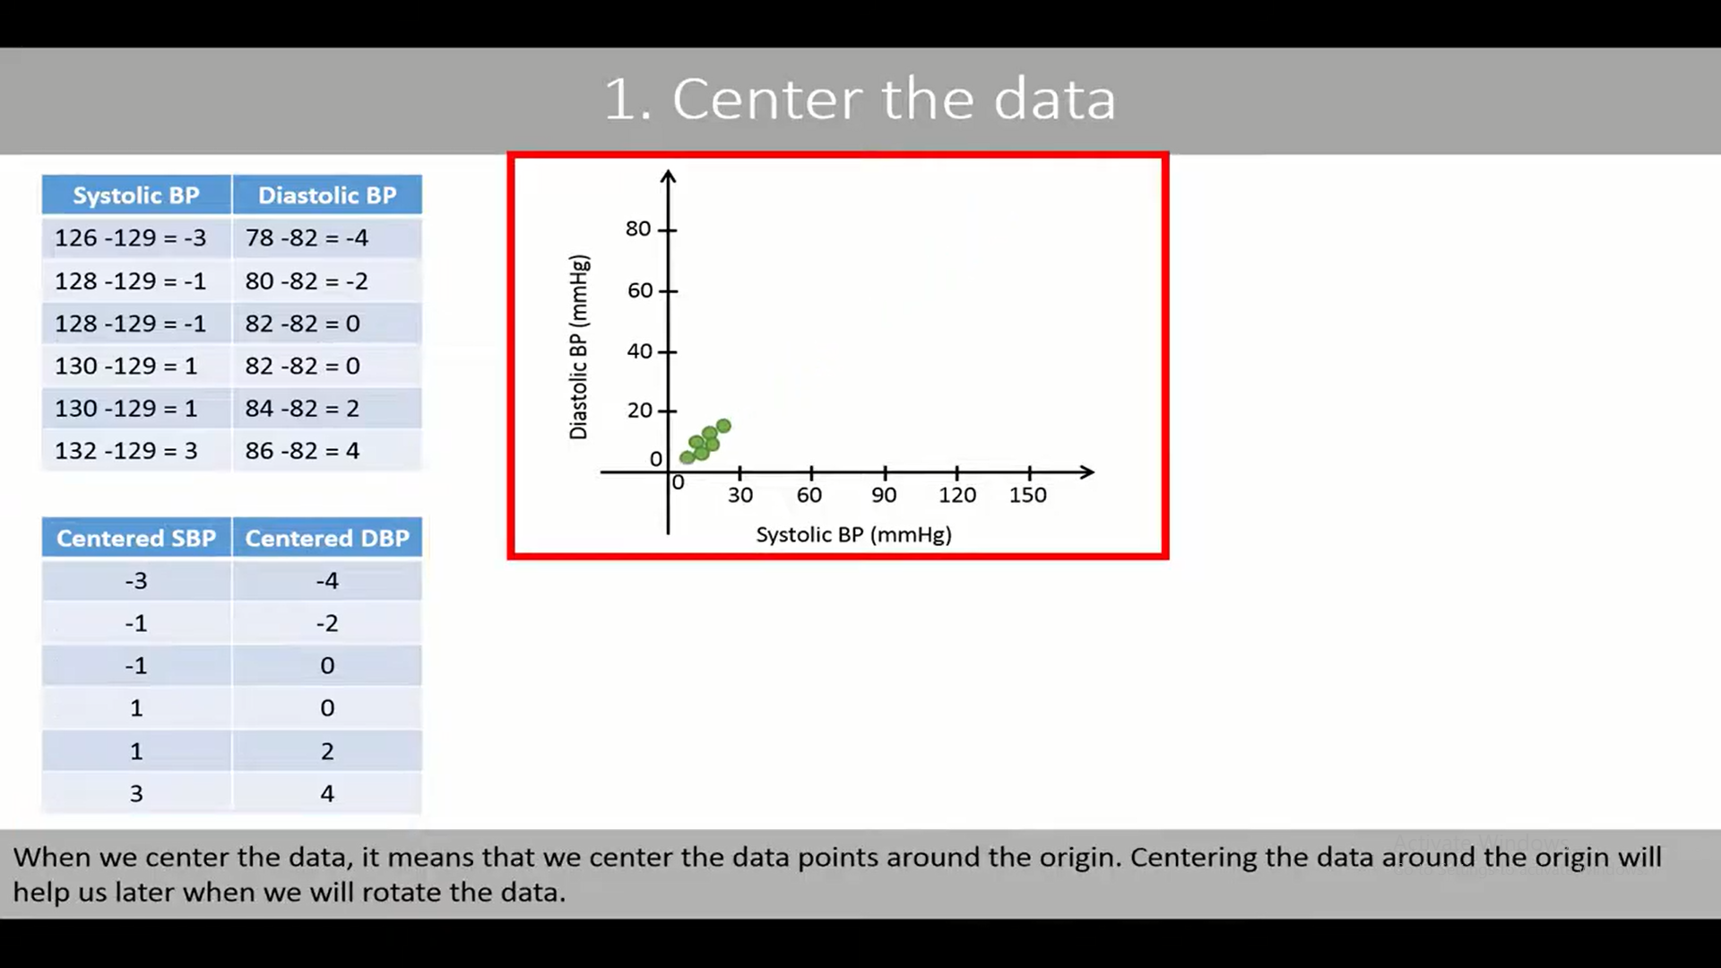

Slide 43
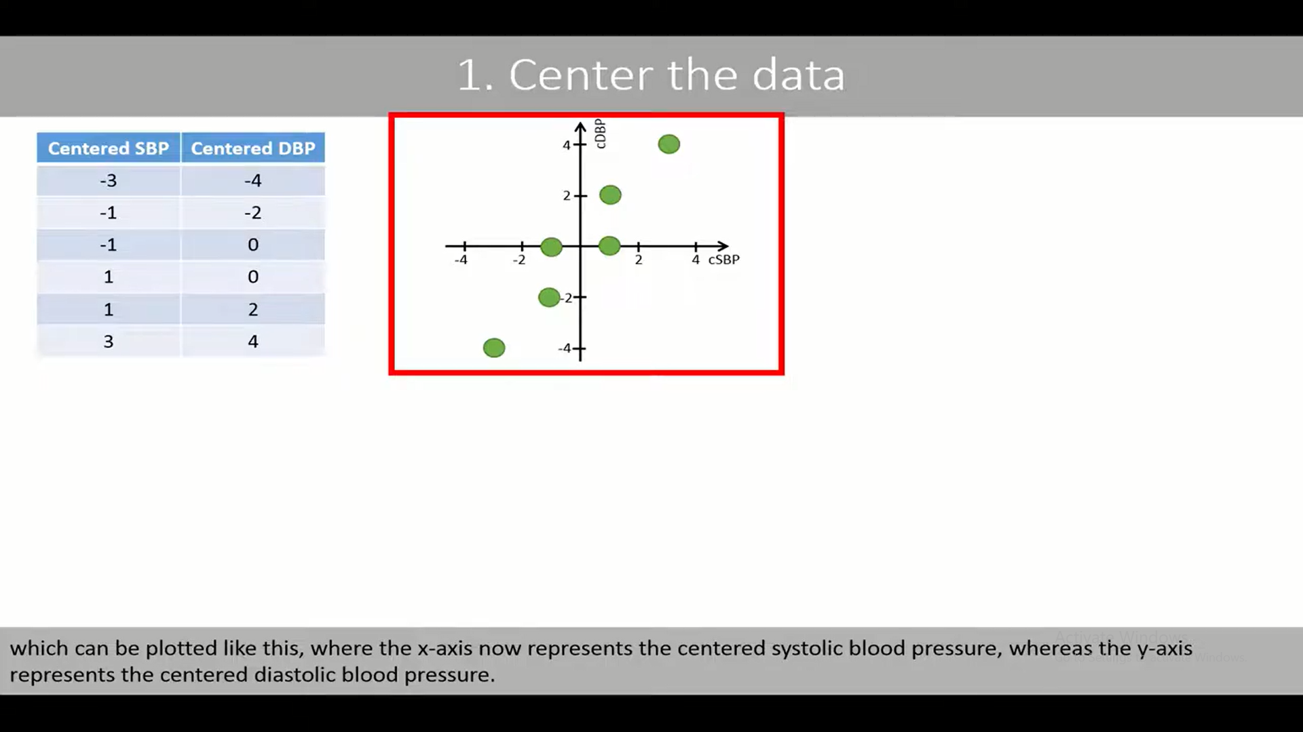

Slide 44
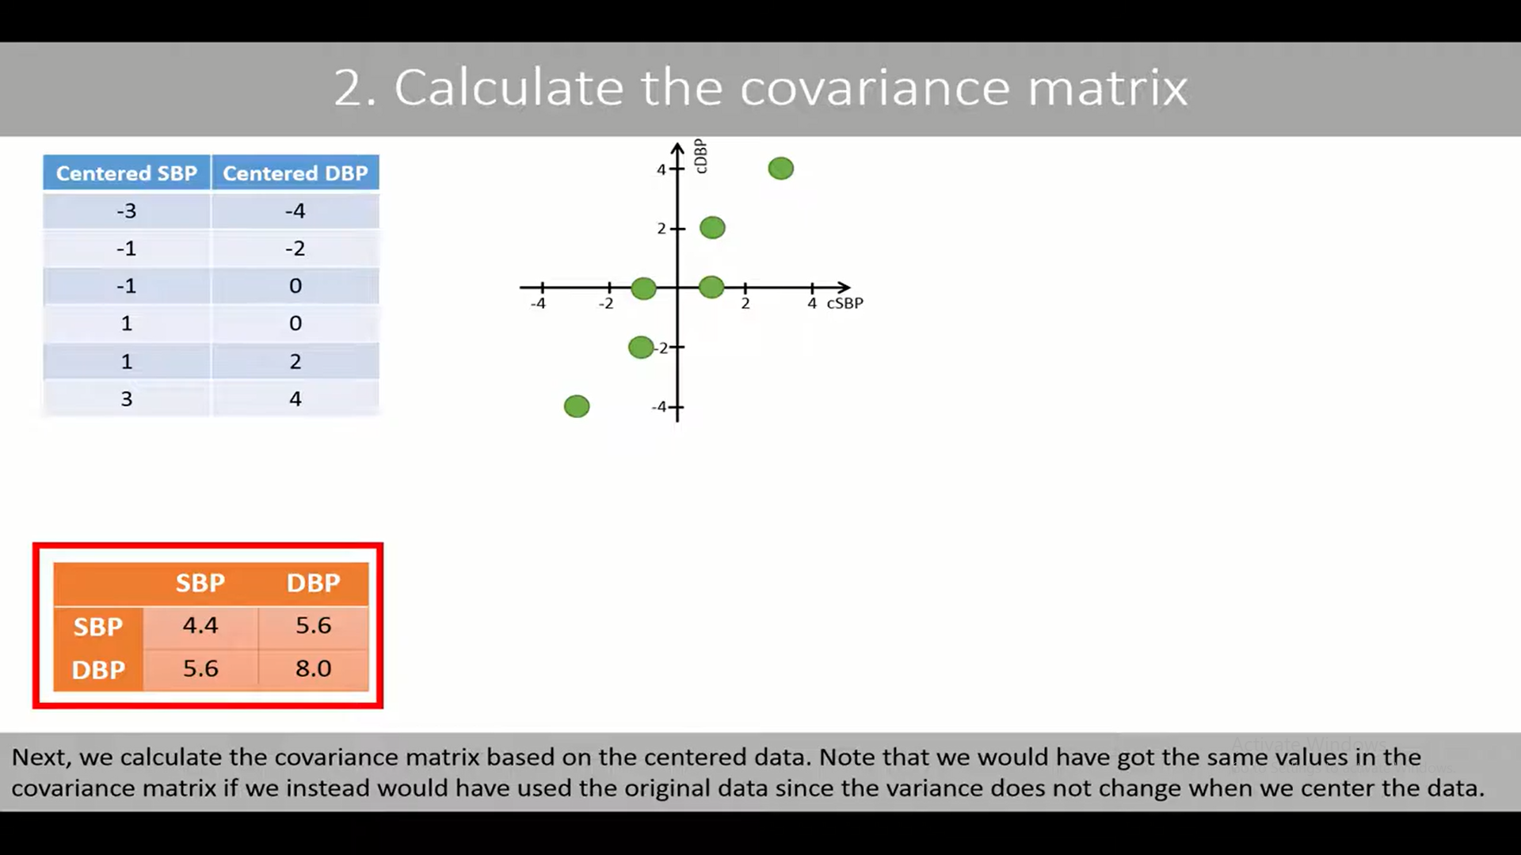

Slide 45
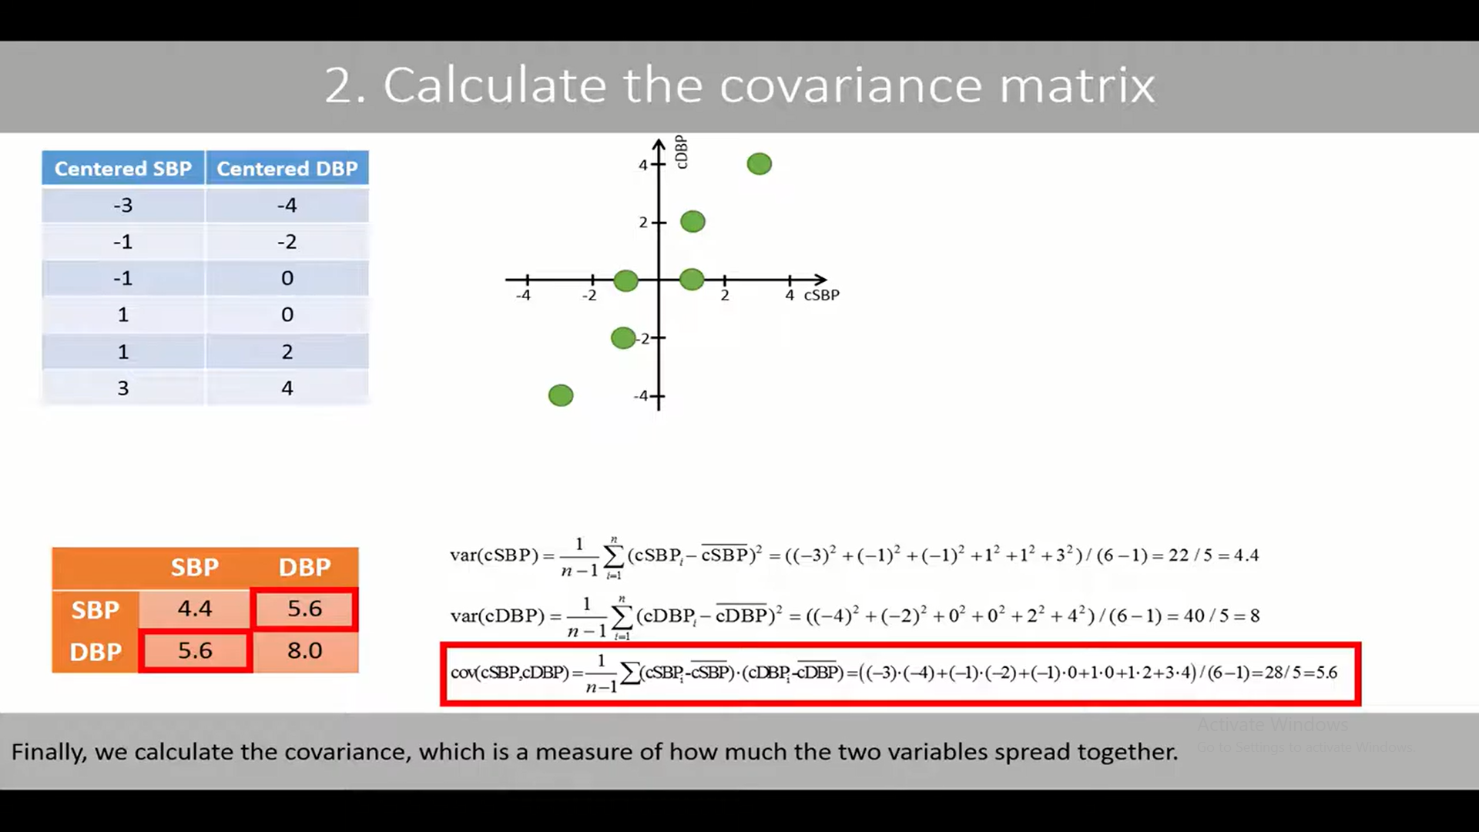

Slide 46
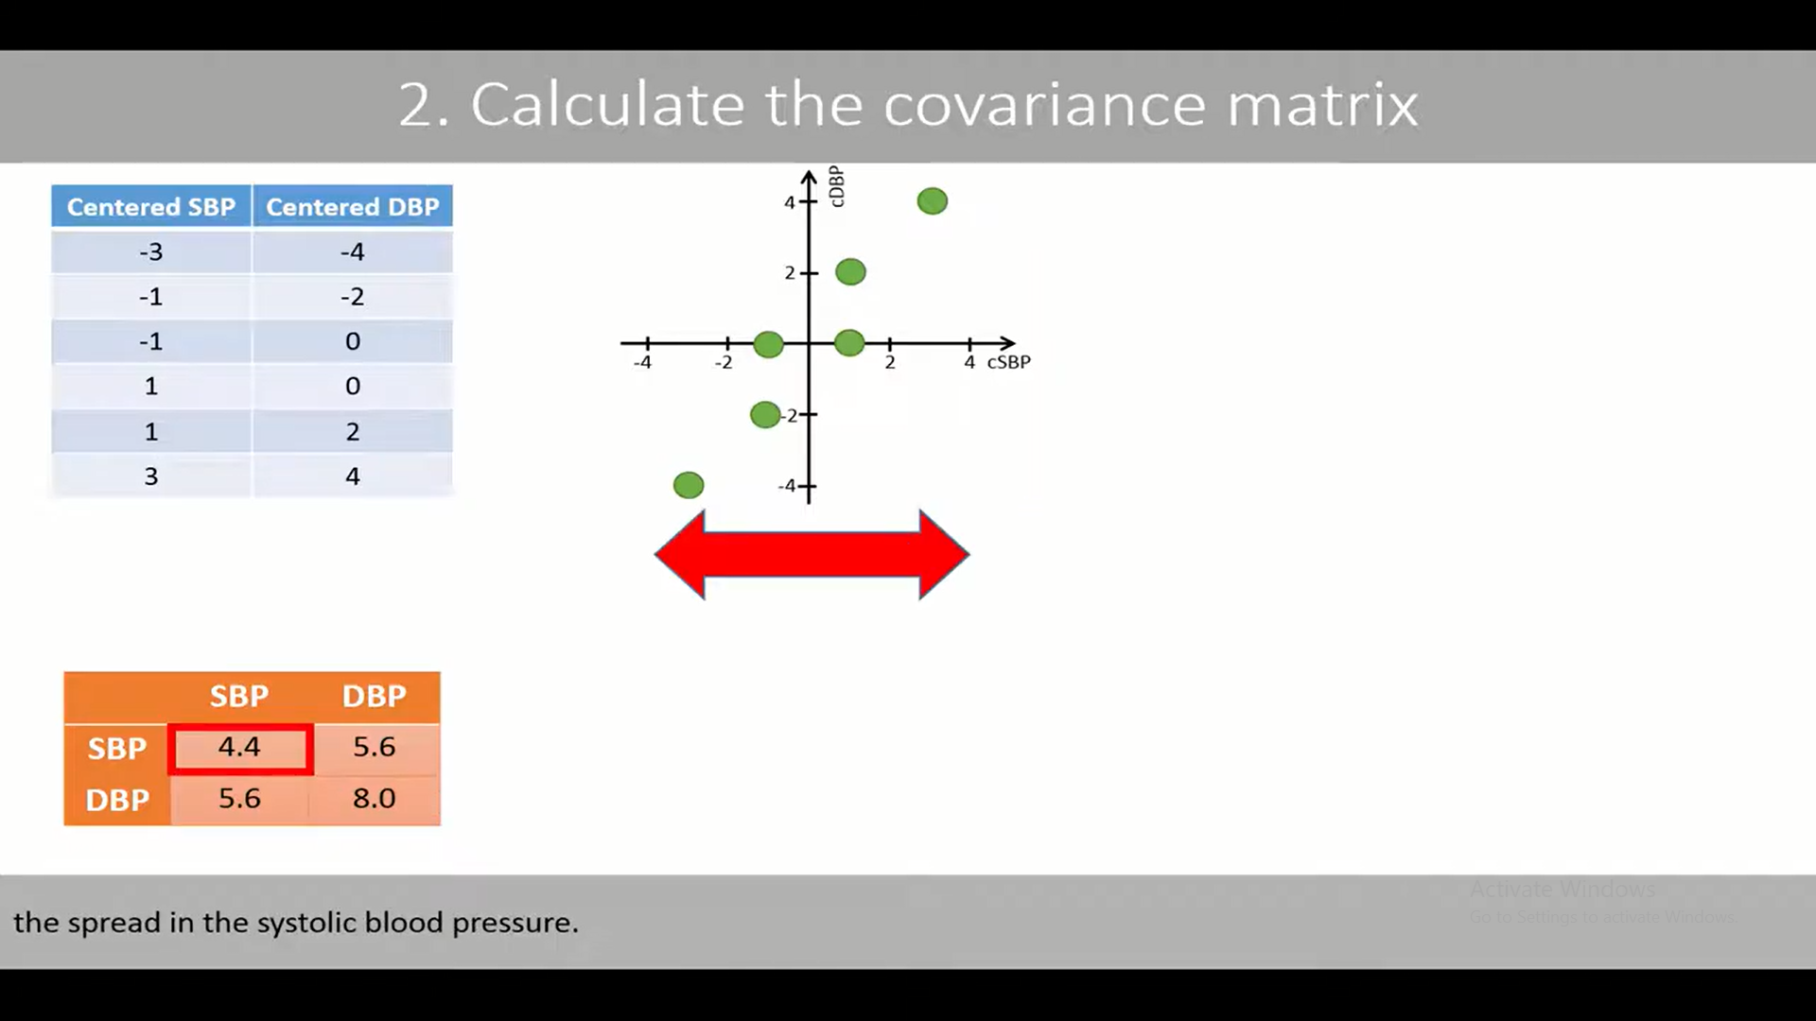

Slide 47
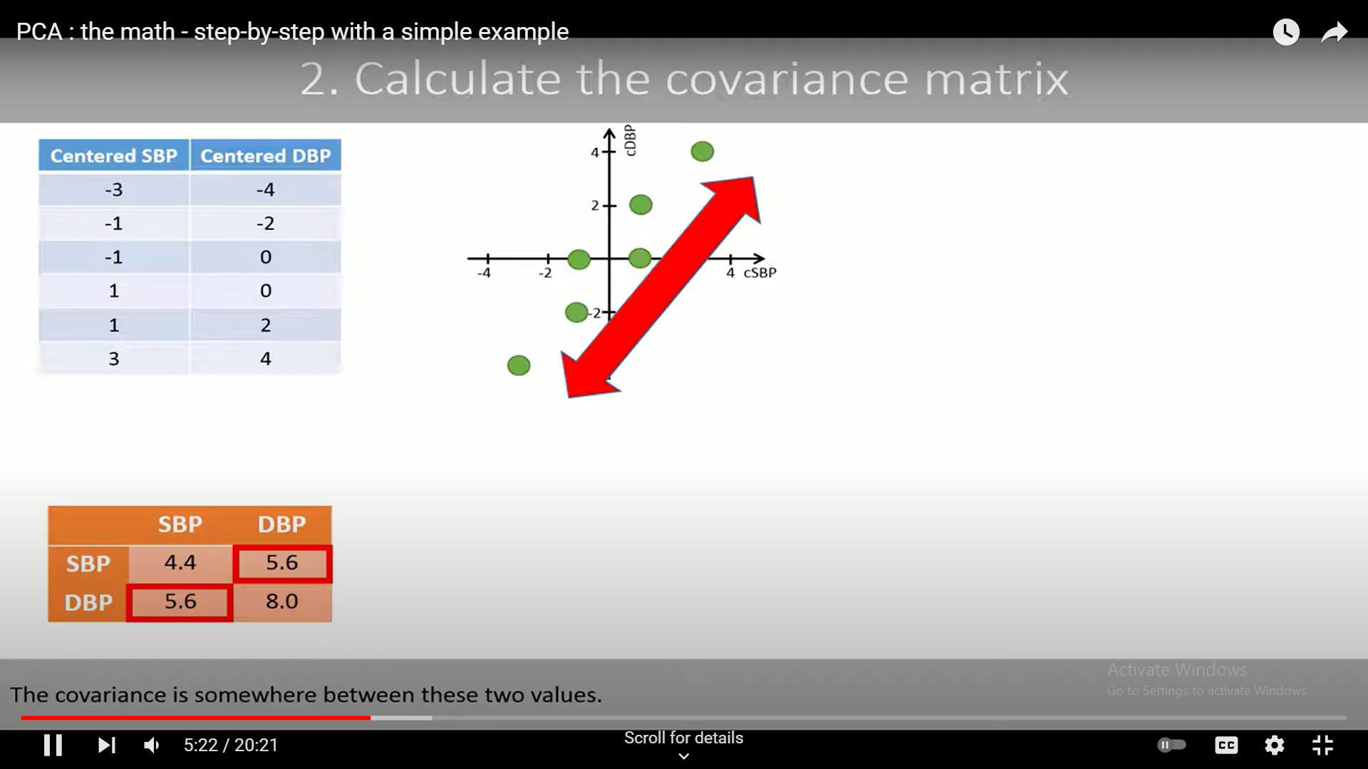

Slide 48
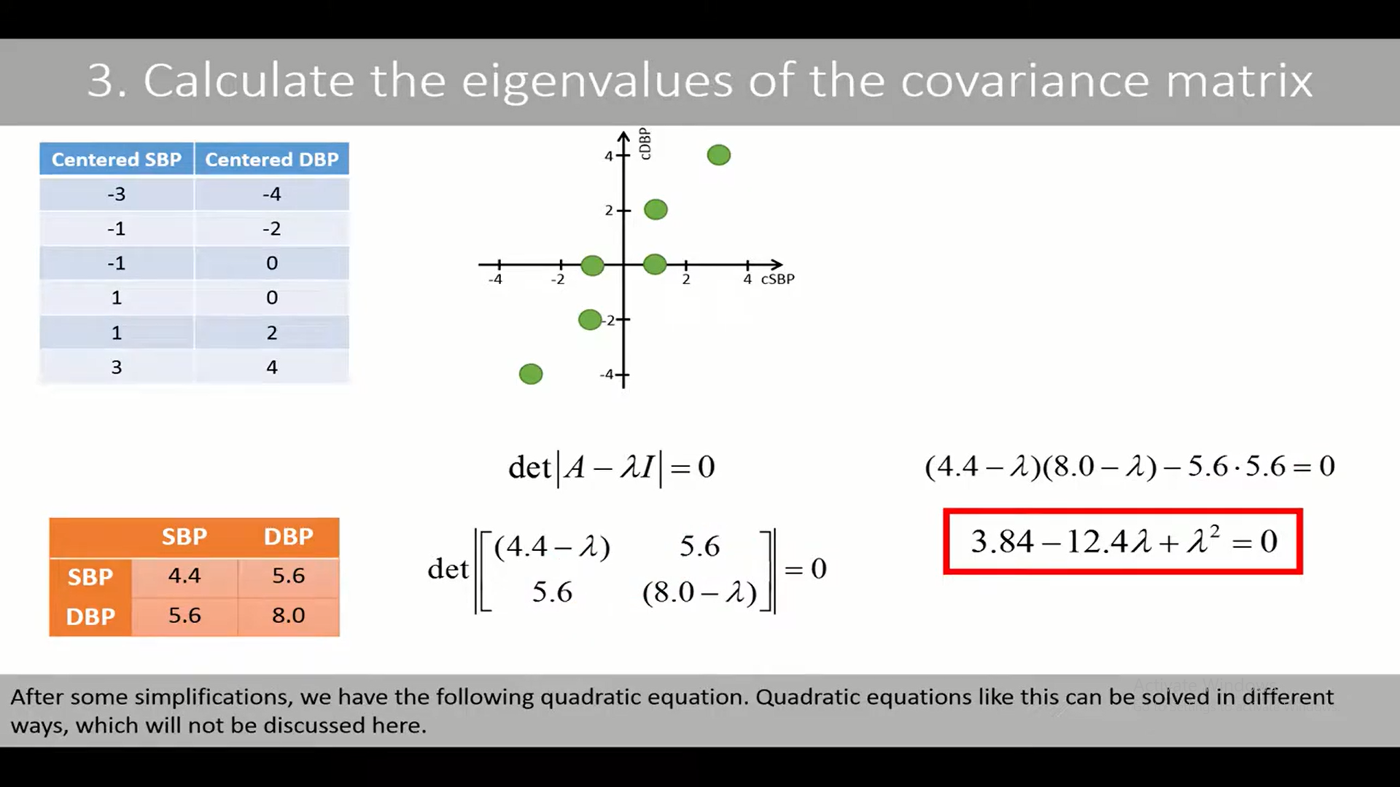

Slide 49
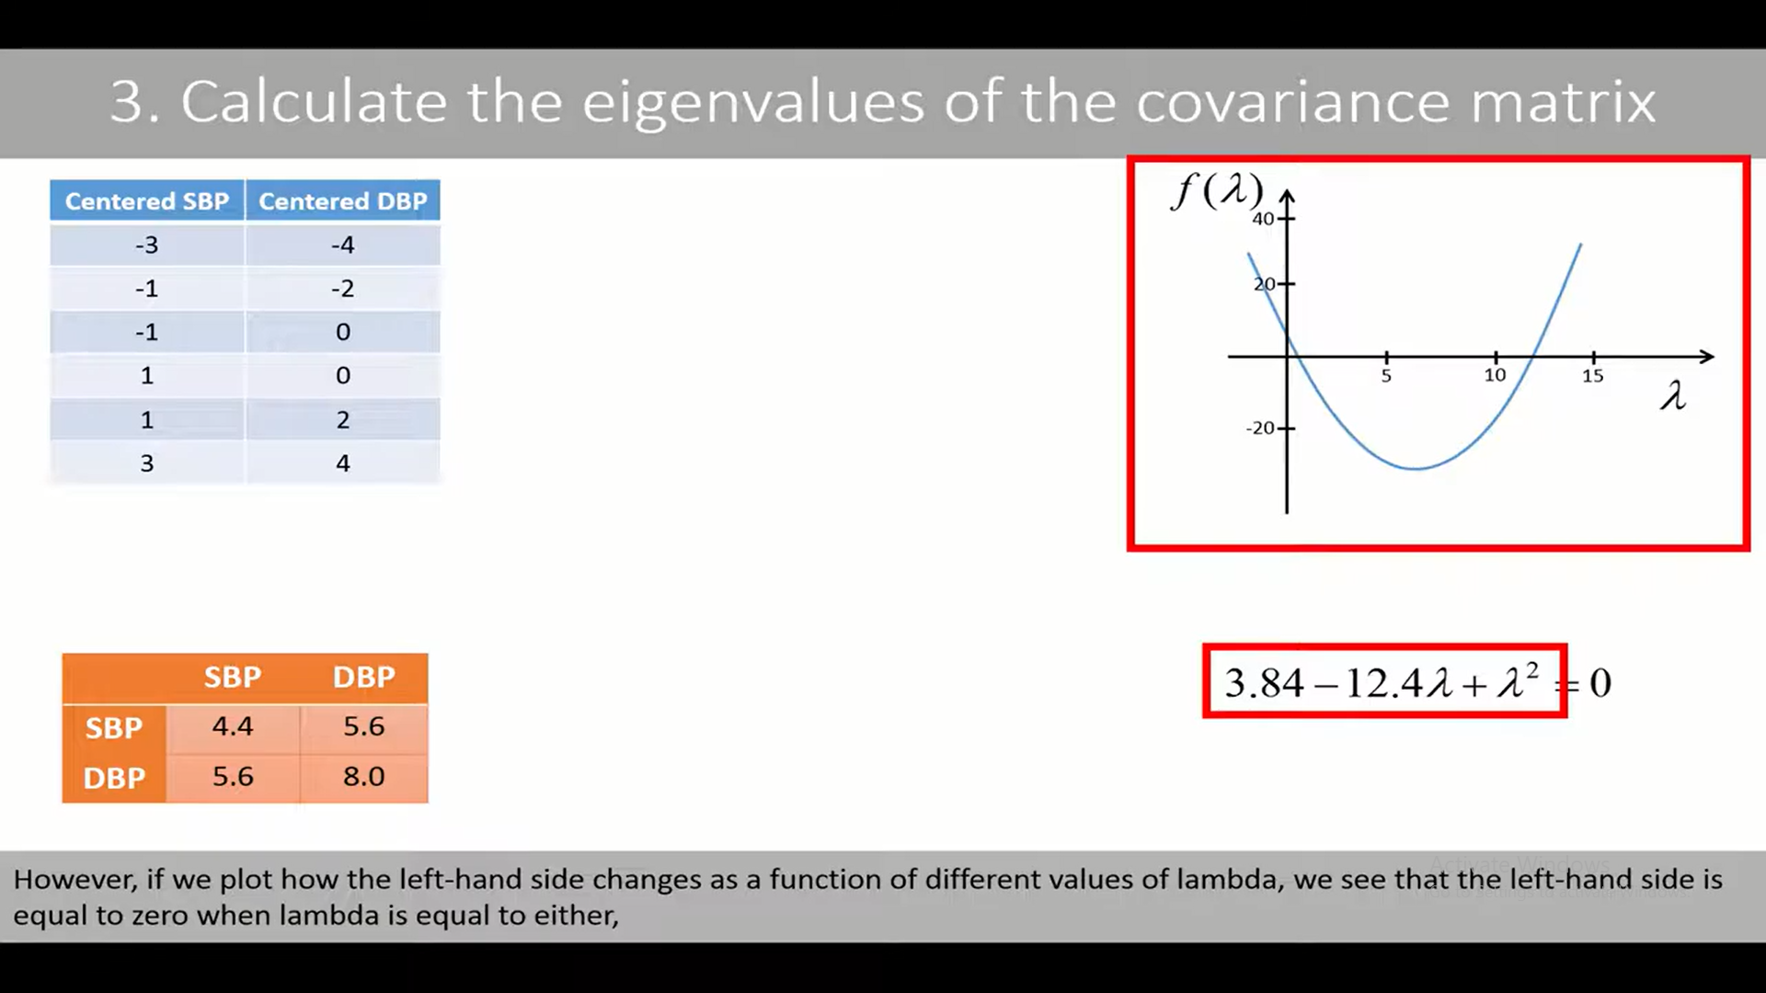

Slide 50
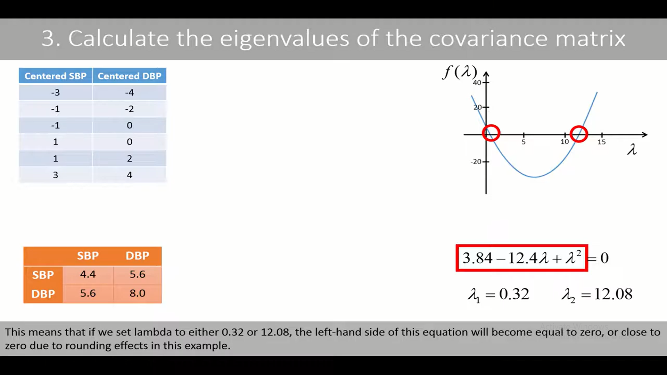

Slide 51
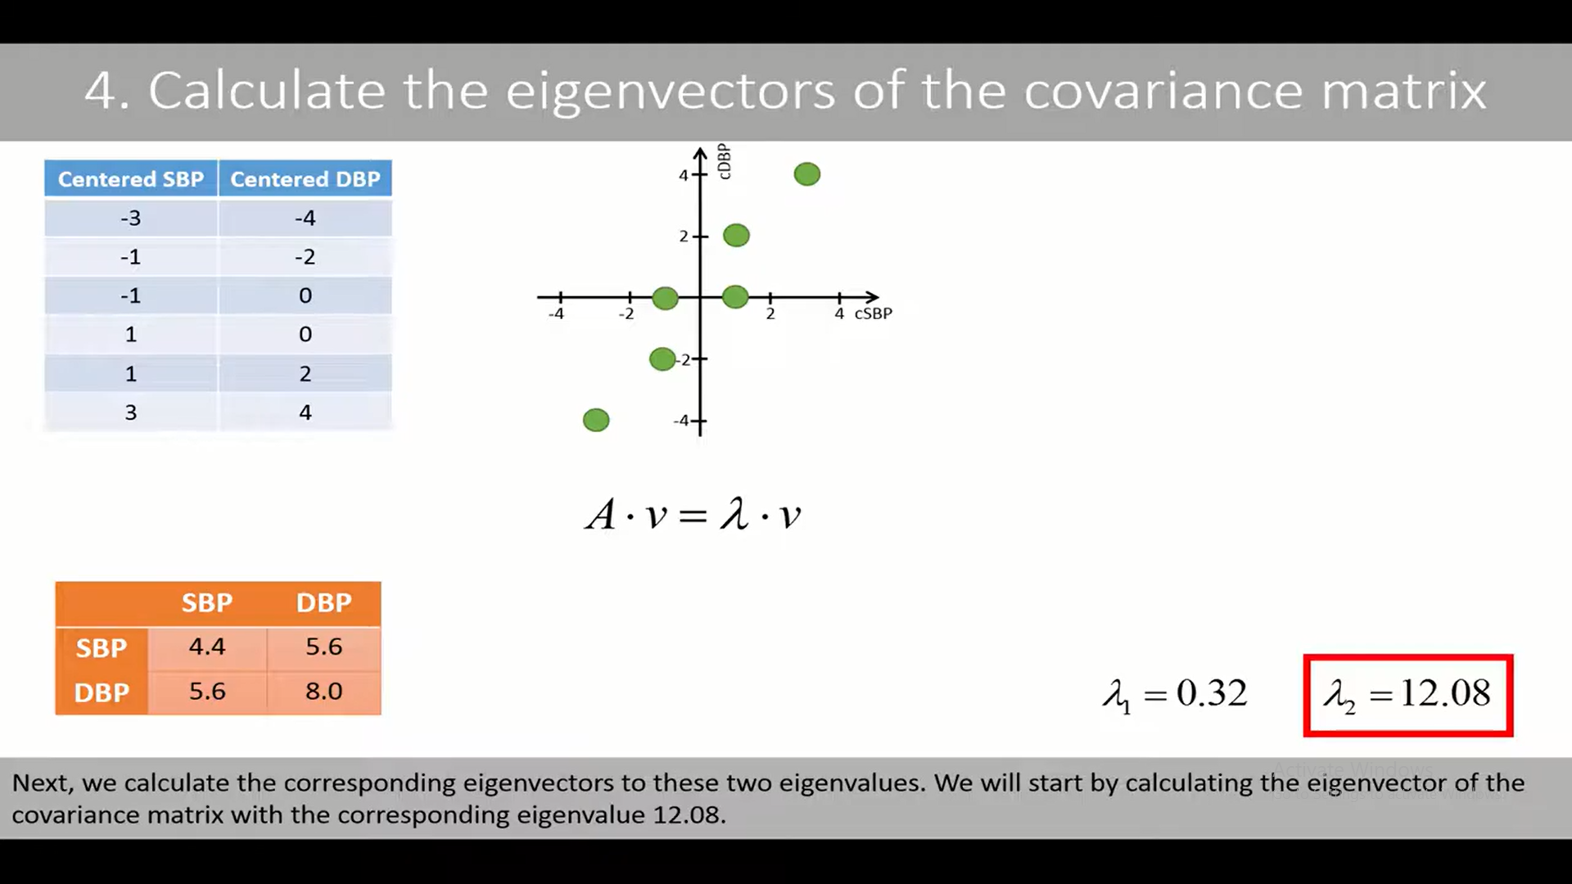

Slide 52
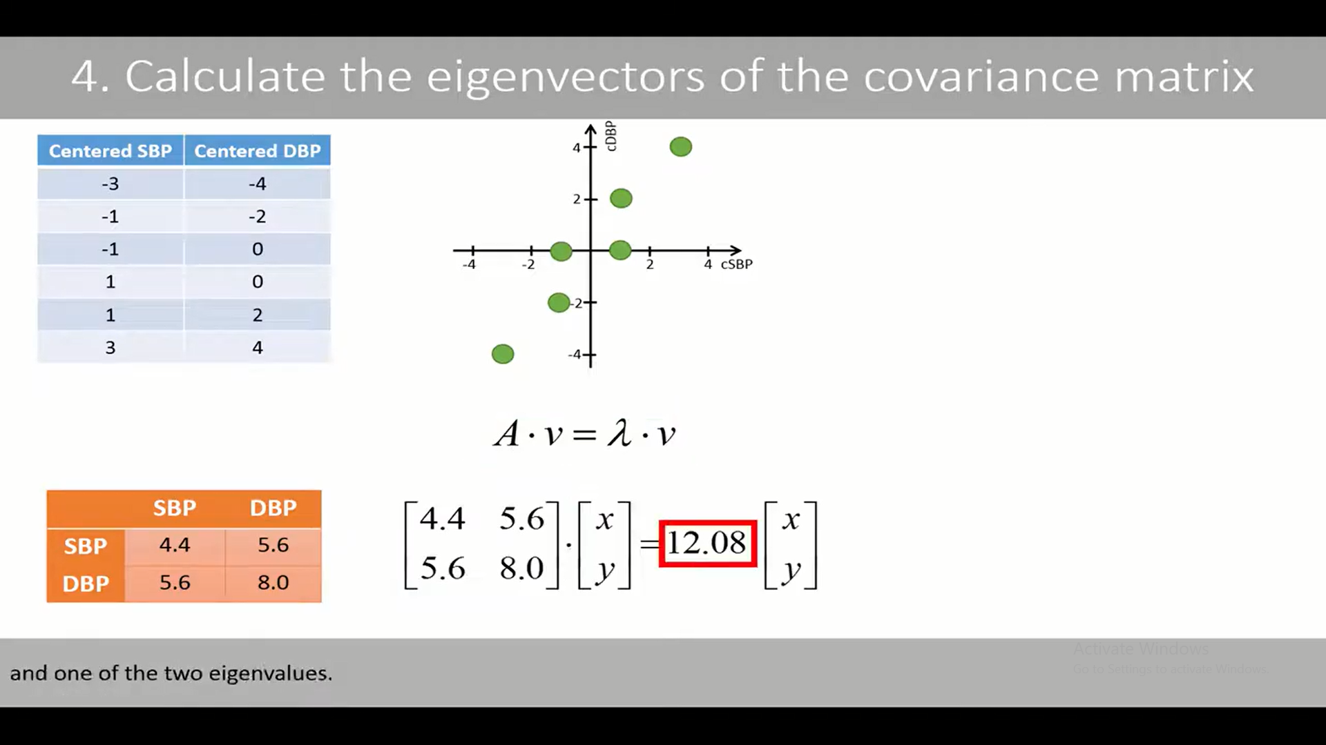

Slide 53
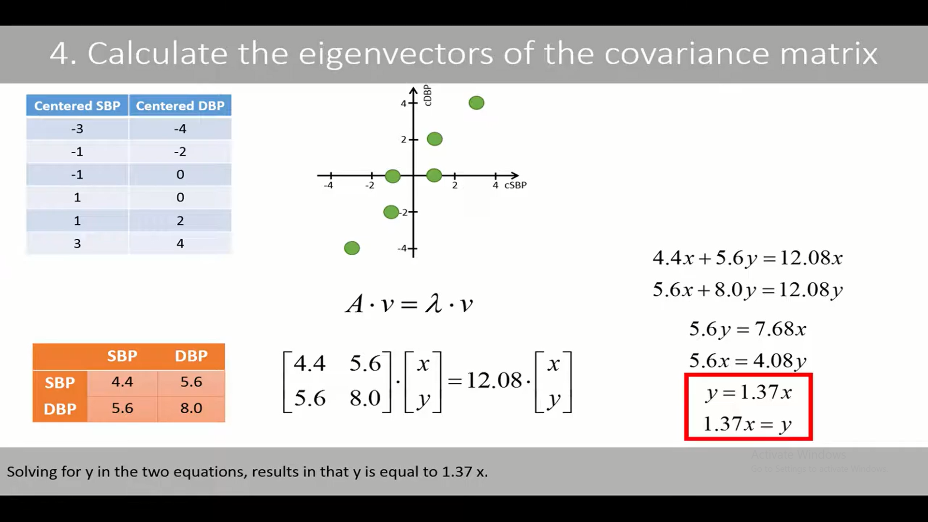

Slide 54
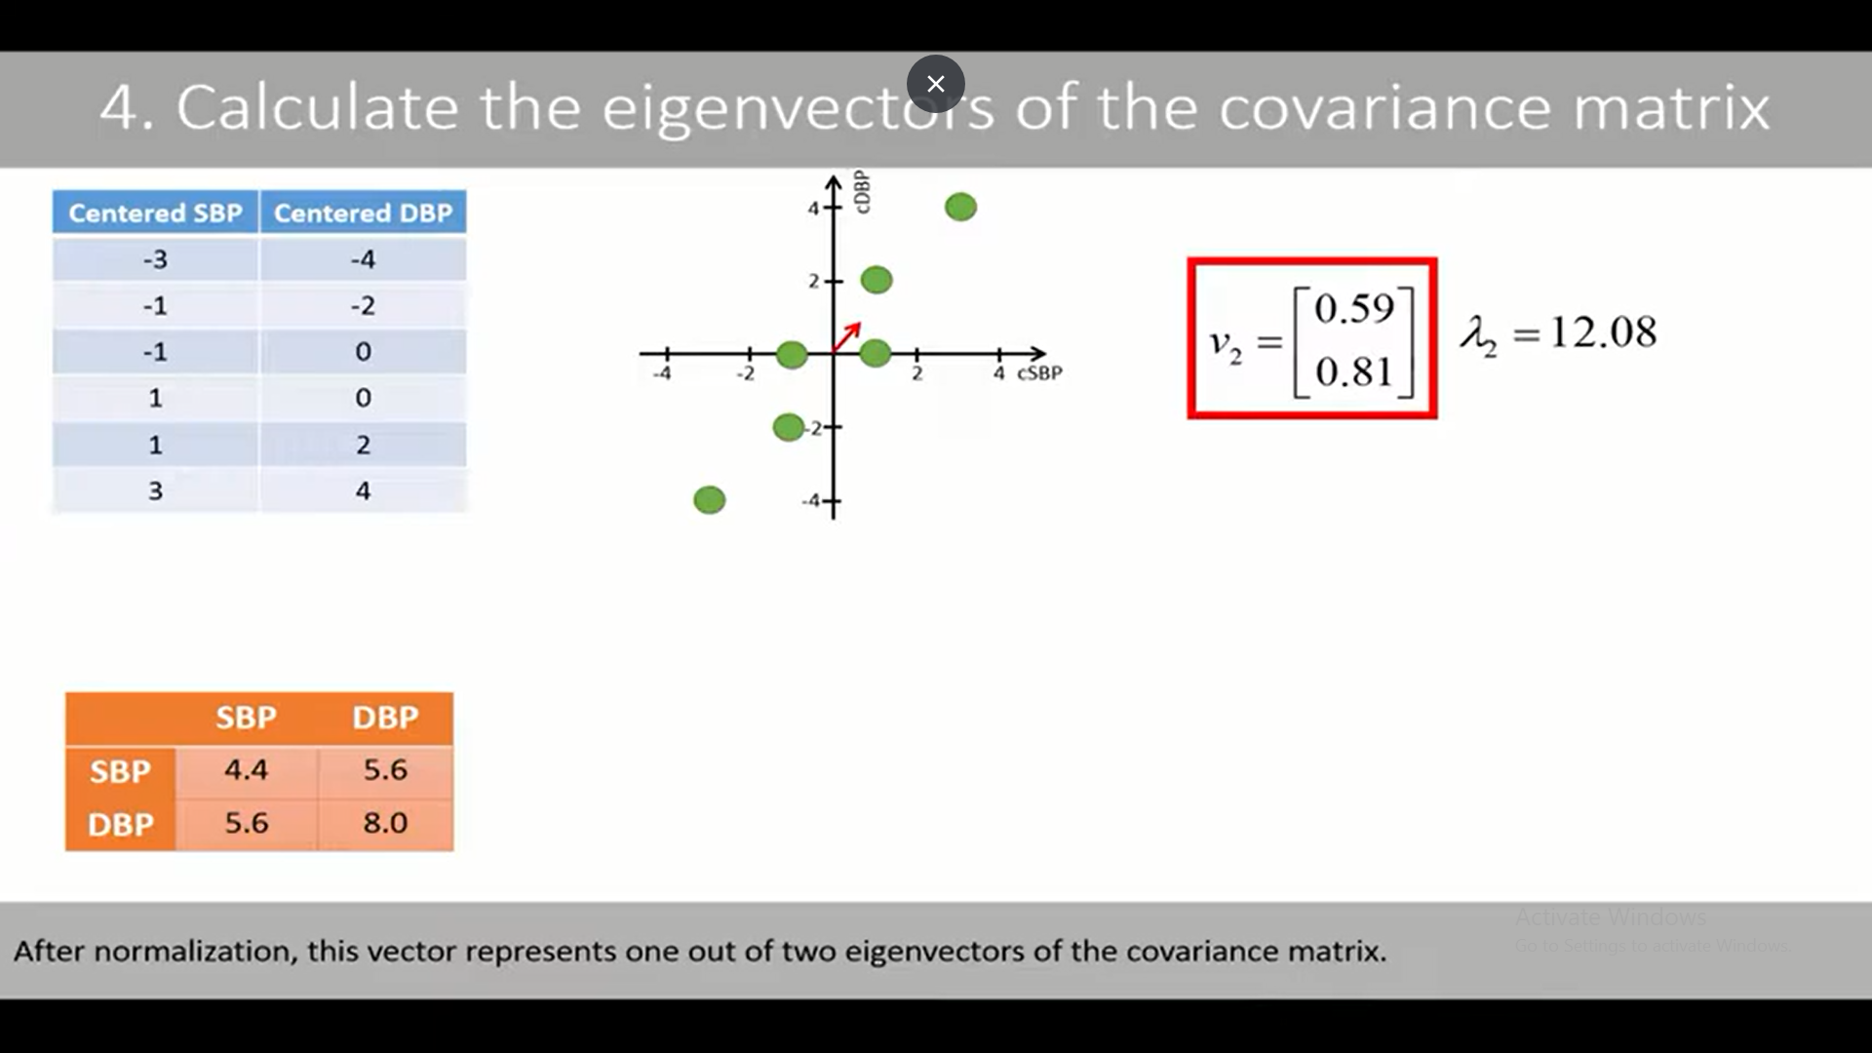

Slide 55
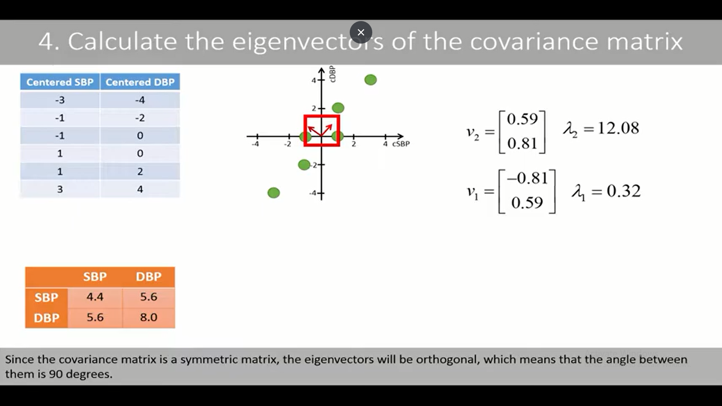

Slide 56
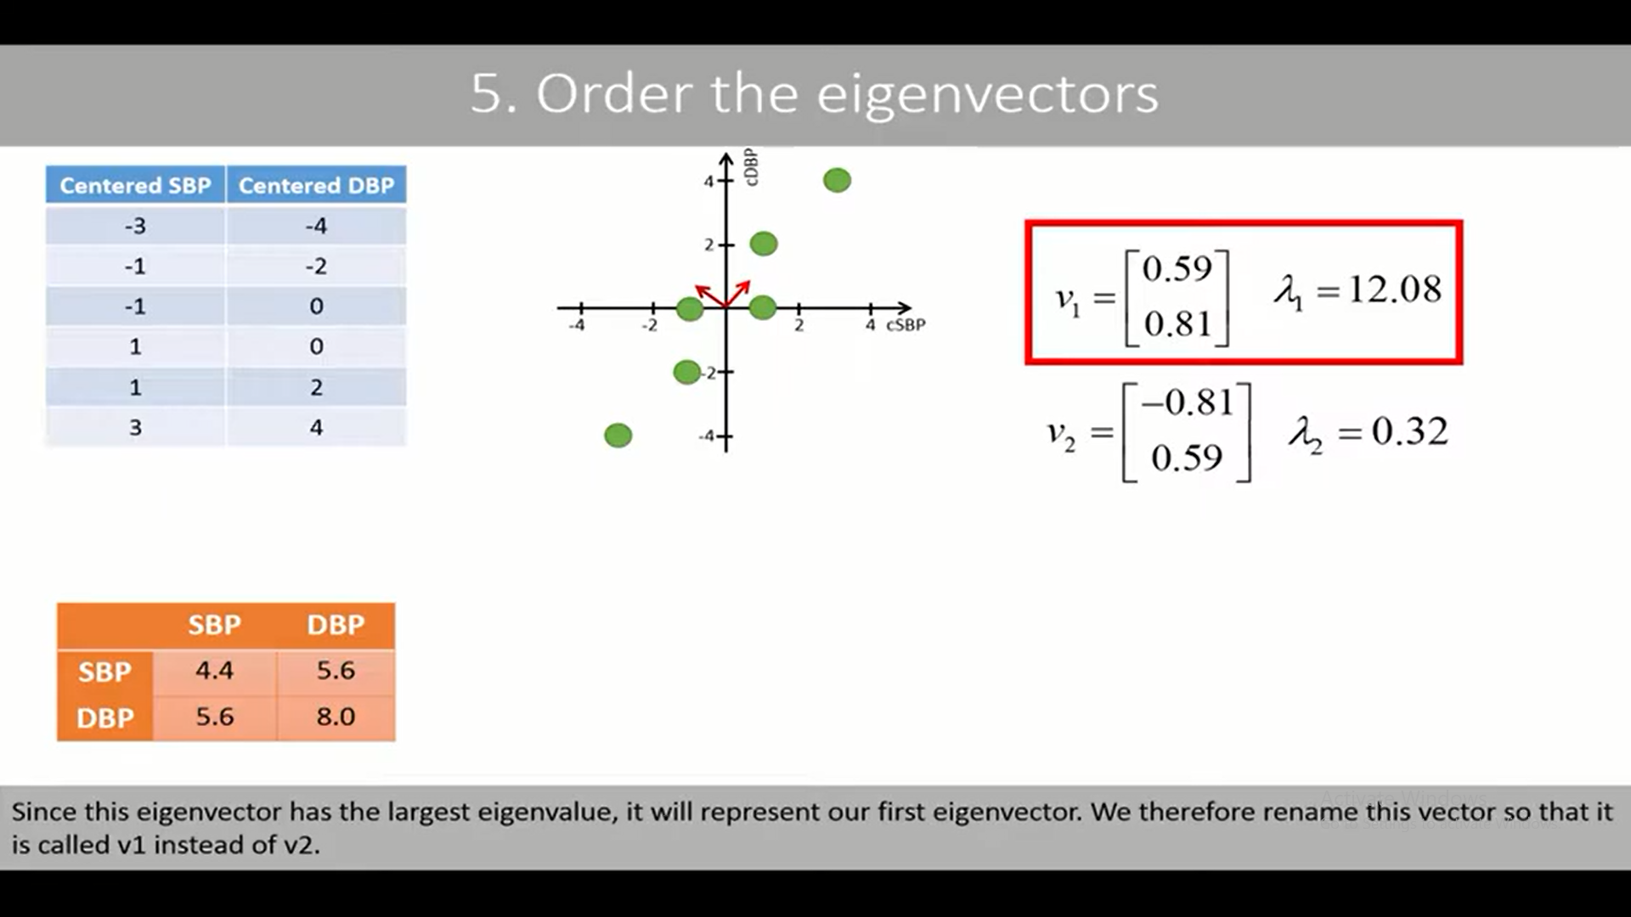

Slide 57
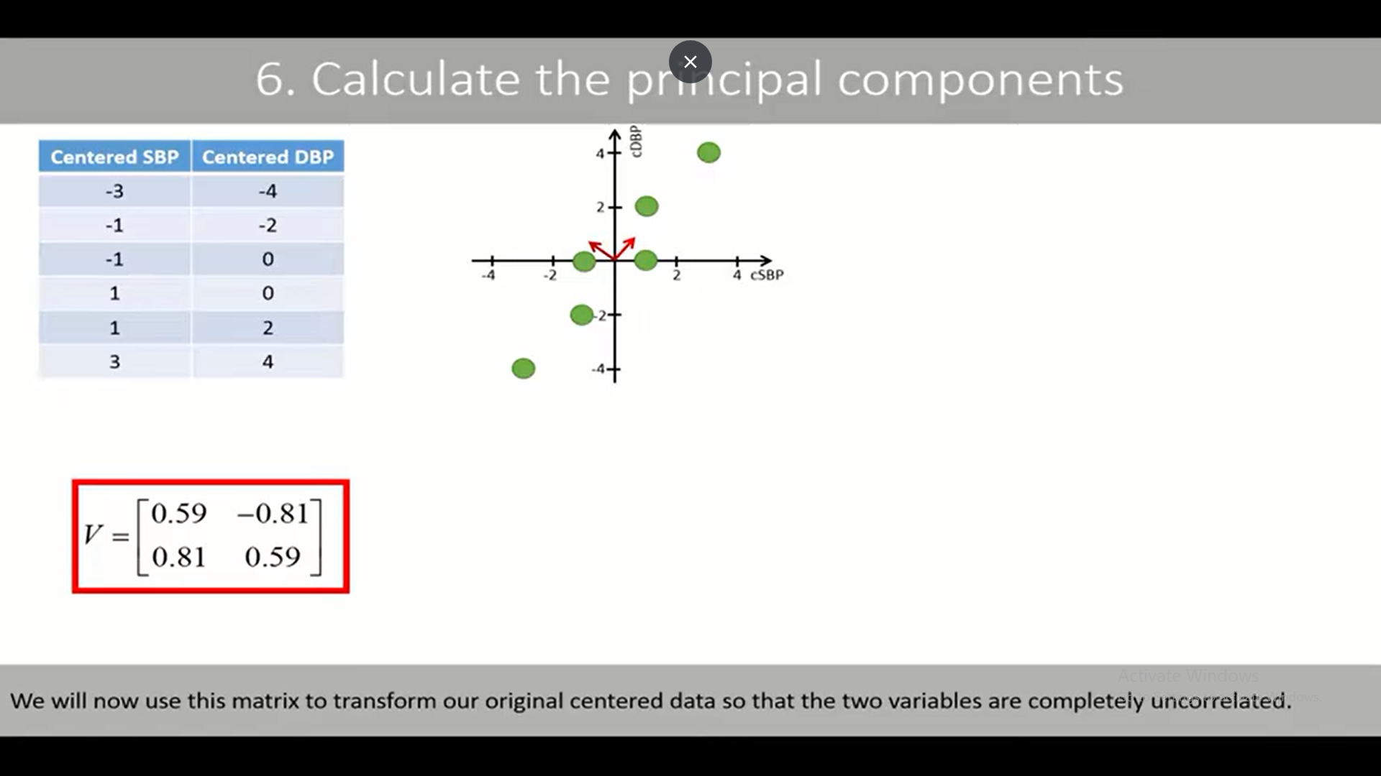

Slide 58
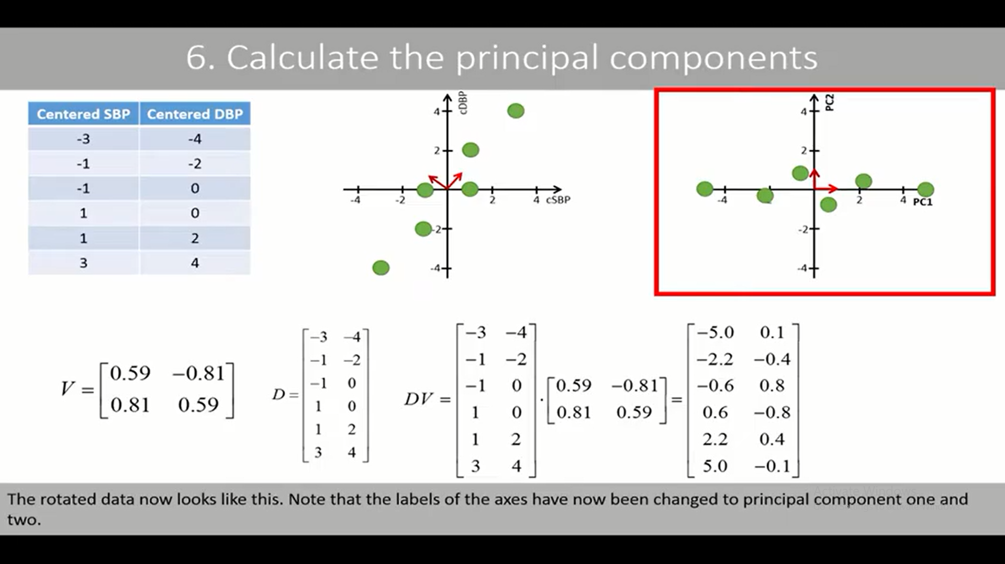
v
v

Slide 59
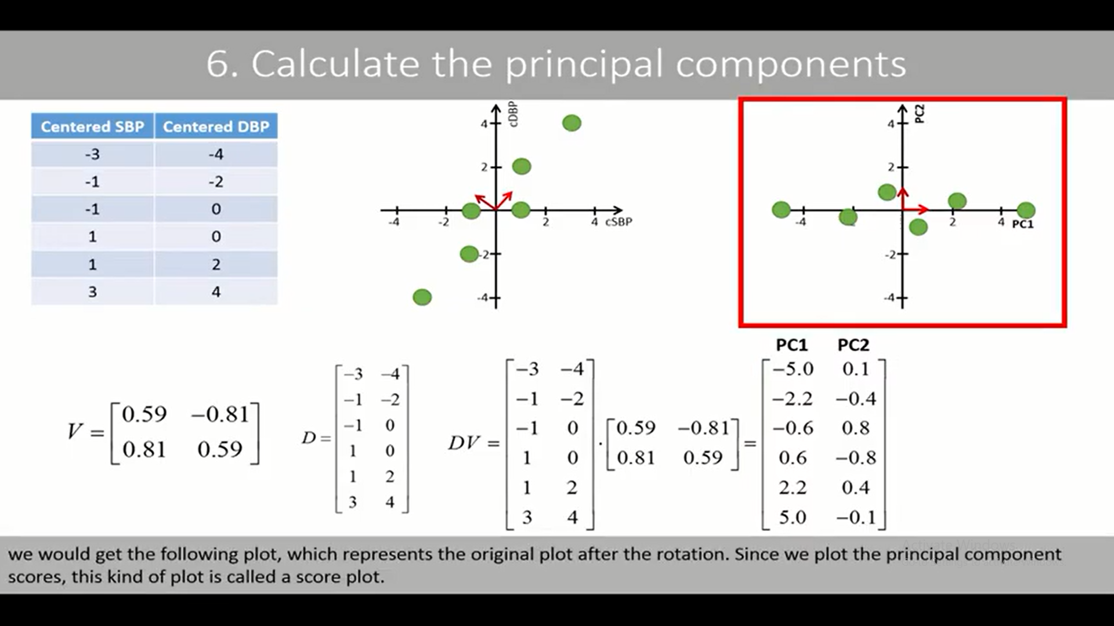

Slide 60
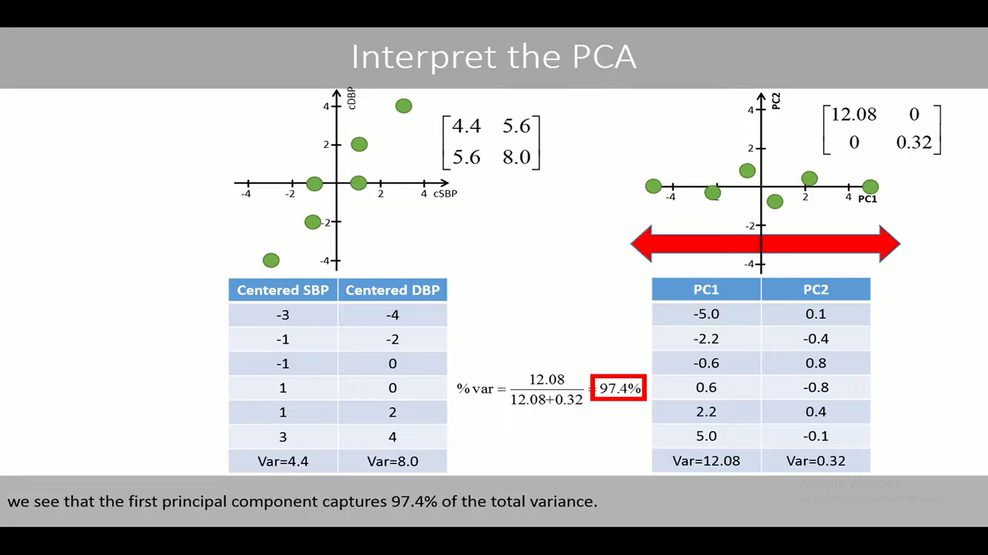

Slide 61
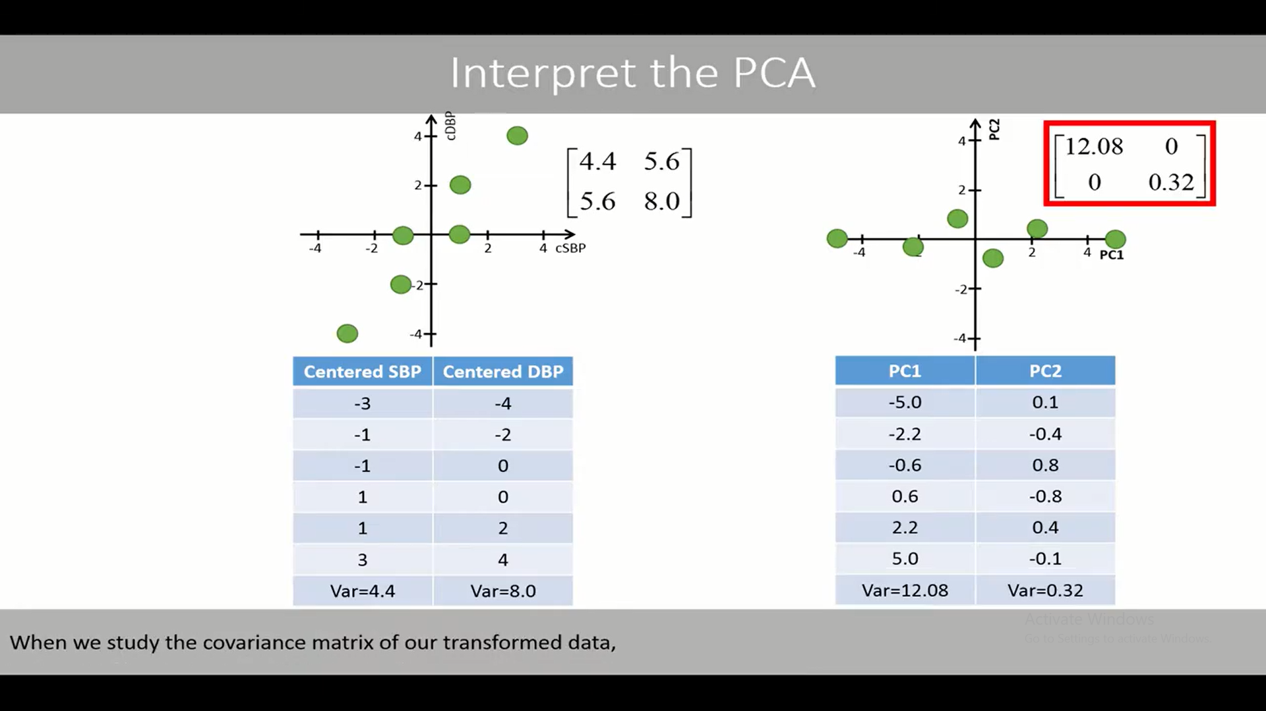

Slide 62
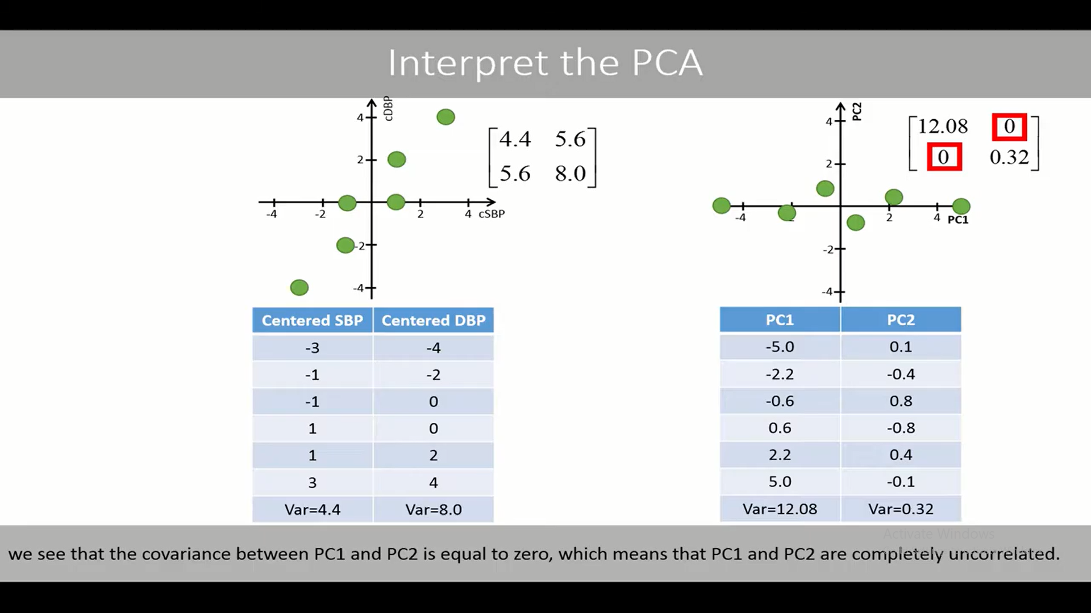

Slide 63
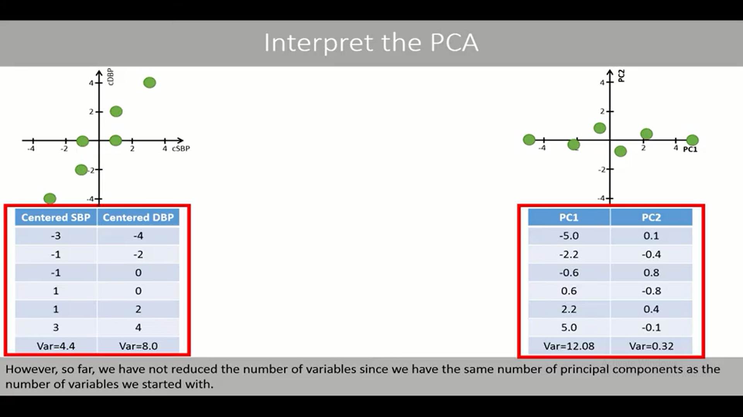

Slide 64
